Slide 1
01. Introduction

Slide 2
1.1 Project Purpose & Aim
mean that human beings will not interact with the highly sophisticated technology of autonomous system. It is to be realized that we are putting highly complex systems in human environment, and they need to coexist with human being. Therefore, it will be impossible to prevent interactions between humans and autonomous Systems.
Basis the research outcomes, the project was divided into 2 phases.
01) Design brief for Phase 1 focused on answering ‘Whether design can help create better Autonomous Systems without disregarding humans in the loop, and how? ’
02) Post Phase 1, the project arrived at a stage where 'humanizing collaboration with Autonomous Systems’ was seen as a beneficial design intervention. ‘Humanizing Collaboration with Autonomous Systems’ became the answer to the ‘how’ and became the new brief for Phase 2 of the project to further research upon.
Since the project catered to various domains in Siemens, the aim was to deliver an approach encompassing benefits for all verticals of AS at Siemens, be it mobility, robotics, Aerial Unmanned Systems etc., which had the flexibility to be specialised for specific domains by integrating domain-specific parameters. From the perspective of Siemens Research, the project’s value lies in the study of the transition to the ubiquity of autonomous systems which is rapid and not at pace with the rate at which humans are getting comfortable with it. This unease, discomfort and scepticism in working together can result in friction and realization of the true potential of autonomous systems in the multiple verticals of Siemens business like the manufacturing industry, mobility, smart cities etc. From the company’s business perspective, successful study of collaboration between autonomous systems and humans was a beneficial step towards designing autonomous systems for human ecosystems instead of eliminating human interactions which isn’t a realistic and pragmatic approach.
The project was a research focused project in the domain of Autonomous System. Due to the nature of the technology, which is at a nascent stage of development and acceptance, and with limited presence in our environment, the project was conceived as an exploratory research project.
The objective of the project was to explore areas of opportunities and find the scope of design intervention, if any, which will help the UXD Team work with the Autonomous Systems group in designing better Autonomous Systems for Siemen’s diverse business domains. Via this project, the UXD team wanted to establish the role of design in creating Autonomous Systems at Siemens and propose a design approach to work together with the ‘Autonomous Systems’ group to create better Autonomous Systems. Therefore, the project was aimed at communicating the benefit of design intervention to the technical R&D team at Siemens for improving in-house creation of ubiquitous Autonomous Systems.
The role of human centered design was question because of the nature of the technology of Autonomous System. The state of art technology in this domain marches towards full autonomy, minimizing humans' interventions. As machine will achieve full autonomy, there’s a belief that humans won’t need to interact with them since machines can operate on their own without human support & intervention. While the later part of machine not needing human support and intervention is what autonomy aims to achieve, this will not

Slide 3
1.2 Initial Brief/Research question
“
Identify the role design can play in the domain of autonomous systems
As we try to achieve full autonomy of machines, identify the role design can play in the domain of autonomous system.
As we try to achieve full autonomy of machines, what role can design play in the domain of autonomous system?
”

Slide 4
1.5 Plan
Discover
Analysis
Identify
Define
Research
Design
Deploy
Understand the domain landscape. Undertake primary and secondary research to fully examine available knowledge, theories and ways of the emerging technology (overall and Siemens’s business specific)
Analyze research finding to understanding problem areas, opportunities and possible design intervention and identify possible design objectives.
Identify the objective for advancing into future Research by establishing the importance of this design direction.
Define the new design brief i.e., goal and objective for further research
Undertake secondary and Primary study for the redefined brief to understand the domain and identify solutions
Design a framework using top-down approach that can be scaled across business vertical of Siemens
Illustrate the deployment of the framework to various use cases and personas via short concept creation
Phase 1
Phase 2
Figure 1. Project Plan & Structure

Slide 5
1.4 Methodology
About Exploratory Research Method
Exploratory research investigates problems that are not clearly defined. It is conducted to gain insight and knowledge about the existing problem; however, exploratory research need not provide a conclusive answer to these problems. Here, a researcher starts with an idea that is general in nature and uses this as a means to recognize issues that can become the focus for future research. An important feature of exploratory research is that the researcher should keep an open mind and be willing to change the direction of their research as they collect more and more insightful data. Exploratory research uses grounded theory approach and is interpretive in nature because it aims to answer questions such as: what is happening?, why is this happening?, how is this happening? It helps researchers uncover answers to questions such as; what is the problem being studied? What is the need for this study? What topics should be included in the study? Unlike a positivist method, where the researcher starts with a theory and tests theoretical postulates using empirical data, in interpretive methods, the researcher starts with data and tries to derive a theory about the phenomenon of interest from the observed data. Interpretive research is a research paradigm that is based on the assumption that social reality is not singular or objective but is rather shaped by human experiences and social contexts (ontology), and is therefore best studied within its socio-historic context by reconciling the subjective interpretations of its various participants (epistemology). [1][2]
The project looked up to Exploratory Research as a tool to identify design interventions in a domain that is at its nascent stage of development and early growth. It aimed to understand the project via interpretive approach, identify problems, opportunities and possible directions to advance into future research. Post this phase of research, the project answered 2 important questions –
Why should design intervene in the domain of Autonomous Systems; what shall be its role, if any? ’
In what area should design intervene and why is that domain of important?
The research advanced into the next phase of ‘How should designers intervene in the selected area of focus for a design solution’. In this phase of Research, the approach was to propose a framework for collaboration that can be applied to different kind of autonomous systems. Instead of a bottoms up approach, a top-down approach was taken for the framework so that it can be applied across business domains. It should have the flexibility of being specialized for specific domain by iteratively factoring in and integrating domain specific parameters by further research. Post the creation of a framework, the project scope was narrowed down to study 2 pillars of the framework in the domain of Autonomous Cars.
The project illustrated via short concepts as to how the framework can be approached and successfully deployed to humanize collaboration in various use case scenarios.

Slide 6
1.4 Methodology
The project studies a domain and technology that is still in the nascent stages of development. Designers need to study the problem in the context of future by understanding the present. New & emerging technology aims to provide optimal solutions for the Preferable future. A preferable future is a future that we think ‘should’ or ‘ought to’ happen [3]. Architects of the future have various thoughts and theories regarding a preferable future and based on their belief, they work towards constructing a preferable future. This project also aims to define certain values and principles for the future of Autonomous System.
However, the larger focus of the project is to work for the ‘Transition period from Now to Preferable Future’. In the domain of autonomous system, a widely agreed preferable future is to achieve full autonomy. While we aim for system which are fully autonomous, in the period of transition we come across various degrees of autonomy technologies existing within human environment, introducing their own complexity in the ecosystem. The project aims to study the transition to full autonomy and propose interventions for this transition period. Any technology that hasn’t fully matured yet bring a certain level of complexity to the environment. Autonomous Technology is a technology that comes with its’ skepticism from human being due to the pessimism around automation that aims to replace humans’ roles in society. So, the project aims to understand this technology and its interactions with human being in its transitional phase. And henceforth, the question will not be ‘Is the system autonomous’, rather ‘To what extent is the system autonomous’?
Possible Future
Plausible Future
Now
Probable Future
Projected Future
Preferable Future
Time
Transition period from Now to Preferable Future
Figure 2. The Future Cone, Voros, J 2017

Slide 7
1.6 Guiding Questions
To start with analyzing the domain of Autonomous Systems, a series of guiding question were formed to get the idea of the complete landscape and help in carving future directions
INTERPRETIVE QUESTIONS
Does an ecosystem that aims to minimize human intervention really need a design intervention
Can the involvement of design result in better Autonomous Systems.
Do we really need to keep humans out of loop?
Even when systems achieve full autonomy, do people interact with AS directly/indirectly/? How ?
Or do AS affect humans directly/indirectly? How?
Can the involvement of design result in better Autonomous Systems.
Can we ever truly eliminate human interactions with autonomous systems even if we achieve full autonomy?
How do humans perceive this technology and to what extent have humans adopted this technologies
Is it important to keep humans out of the loop. What value does keep ‘humans out of the loop’ bring to the autonomous ecosystems.
People might argue that we don't need design for a systems that aims to minimise human intervention as it achieves full autonomy, it is true?
Can human augmentation in autonomous ecosystem be beneficial or is it better to keep humans out of loop. What value will ‘augmenting humans’ in this ecosystem bring?
FACTUAL QUESTIONS
What is the current state of art in Autonomous system
What does it mean to be fully autonomous
What are the current application of Autonomous Systems
What is the dev process of Autonomous Systems at Siemens
What are the domains where this technology is being used
What are the current use cases for Autonomous Systems

Slide 8
02. Discover

Slide 9
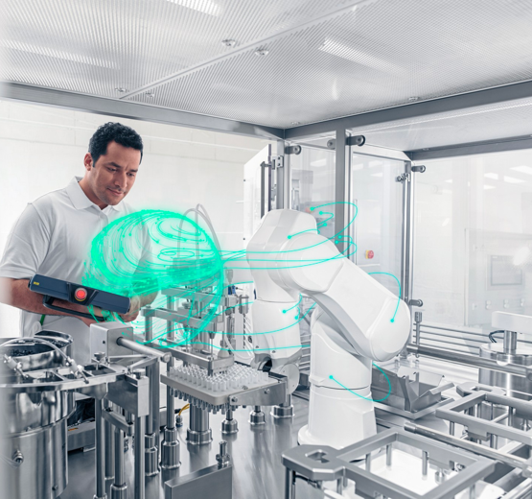
2.2 Autonomous Technology ~ About
humans. AS leverage these powers to work independent of human assistance. Therefore, we as humans are shifting parts of our responsibilities which are better handled by Autonomous systems to take out time for activities that demand human intellect and rationale.
Autonomous systems are rapidly being deployed in various domains like mobility, industrial manufacturing aerial surveillance to support as technical support.
To start with, the project aimed to understand the domain of Autonomous System with technical clarity which included understanding the core idea of autonomy, its role in autonomous systems and the core structure of an autonomous system.
WHAT IS AUTONOMY?
According to Cambridge dictionary, autonomy is the ability to make your own decisions without being controlled by someone else. We take this definition as the basis of autonomy through the project. Autonomy defined the ability someone/something has to be independent, govern itself and make their decision for themselves.
WHAT ARE AUTONOMOUS SYSTEMS
Fully autonomous Systems are complex technical systems which are capable of making their own decision without human intervention. Autonomous systems include a variety of technologies like self driving cars, unmanned aerial vehicles, drones, robots in manufacturing industry etc. Autonomous Systems are systems capable of making their own decision & framing a plan of action to achieve a goal while understanding/keeping in mind the changing context and situation around them and actively adapting to it.
NEED AND POPULARITY OF AUTONOMOUS SYSTEMS Due to advancement in technology, machines are capable of doing work much more efficiently, accurately and fast than,
Image 1. Siemens Autonomous System

Slide 10
2.1 Autonomous Technology Growth
Gartner Hyper Cycle for Emerging technology aims at understanding various emerging technologies that show promise in delivering competitive advantage over the next 5-10 years. The 5 main components of Gartner’s hype cycle are-
Innovation Trigger : A potential breakthrough that kick things off
Peak of Inflated Expectation : Success stories based on early publicity, hype and buzz in market. Interest limited to few players
Trough of Disillusionment : Interest wanes as experiments and implementations fail to deliver.
Slope of Enlightenment : Better understanding of the benefits with integration of more use cases resulting in 2nd & 3rd generation products.
Plateau of Productivity : Mainstream adoption starts to take off, with broad market applicability and relevance.
Currently the most domains of autonomous systems are at the initial stage where a technical breakthrough has kicked off innovation in the domain. Apart from this, ‘Autonomous Self driving Level 4’ is moving towards ‘Trough of Disillusionment’ as implementations aren’t successful
The current states of various domains of Autonomous Technology
Figure 2. Gartner Hype Cycle for Emerging Technologies, 2019

Slide 11
2.2 Autonomous Technology ~ About
Objects
Capable of : Action
Configuration : attributes
Agents
Capable of : Action
Configuration : attributes
Goal or set of goals
Autonomous Systems
Capable of : Action
Configuration : attributes
Goal or set of goals
Motivation
Environment
Figure 3. Structure of an Autonomous system
actions
attributes
goals
motivation
Capabilities
Perceivable qualities
Characterizes the agency.
Intrinsic & non derivable ; defines its autonomy

Slide 12
2.2 Autonomous Technology ~ About
all entities(object, agents, AS). An object must be situated in an environment.
Interactions
which happens when actions are performed in environment ; effects of interactions are defined with reference to current environment and actions taken.
Goal
State of affairs to be achieved in the environment.
Agent
Instantiation of an object with an associated goal or a set of goals. An object is an agent if it serves a useful purpose, either to a different agent or to itself. Therefore, an agent is an object which satisfy a goal or set of goals. It may revert to being an object. We don’t require an object to be intelligent for it to be an agent. An agents is thus defined in relation to its goal.
Eg : If we store coffee in the cup, then cup is agent for storing coffee-serves our purpose; has adopted our goal to have the coffee stored. It will also be an agent when kept on stacked papers used as a paperweight. Coffee cup have goals imposed upon/ascribed to it.
Agency
the capacity of individuals to act independently and to make their own free choices. Due to lack of agency, agents usually adopt goals of goals are ascribed to it. Agents that have agency can generate their own goals i.e they are not not dependent on the goals of others.
Technical structure of autonomous systems
The project derive its understanding of the technical structure from M. Luck and M. d’Inverno’s work [4]. For the understanding of the rest of the project, the structure of Autonomous System is as defined in Figure 3.
Autonomous systems are agents which have intrinsic motivation that is non derivable. This motivation and defines the agency of an autonomous system i.e., it defines the nature of autonomy of an autonomous system.
Actions
An actions is a discrete event which changes the state of the environment(capable of, competency)
Attributes
Attributes are perceivable features(configuration)
Object
Entity which comprises of a set of actions(capable of) and set of attributes(configuration).
E.g. Coffee mug eg : Its capabilities state that it can contain liquid while its attributed state that it is white, stable and made of china
Environment
A set of attributes that describes all features of the world and

Slide 13
Autonomous agent possess goals which are generated from within rather than adopted from other agents. Such goals are generated from motivation.
Motivation (teleological)
Higher level non derivative components characterizing the nature of the agent. A motivation is any desire or preference that can lead to generation or adoption of goals, and which affects the outcome of the reasoning or behavioral task intended to satisfy those goals [5].
A motivated agent is thus an agent that pursues its own agenda for reasoning and behavior in accordance with its internal motivation. Since motivation aids in intrinsic goal generation, it is critical to achieving autonomy. Therefore, an autonomous agent must necessarily be a motivated agent.
Autonomous Agent
An agent with set of intrinsic motivations that defines its agency is an autonomous agent.
E.g.: The coffee mug cannot be an autonomous agent because even though it has goals, they aren’t self generated but ascribed to it.
However, a robot can have certain degree of autonomy in the sense that it may have a mechanism to generate goals depending on the environment. Suppose the robot has motivation of achievement, hunger and self preservation, where achievement is defined in terms of fixing tyres onto a car on a production line, hunger is defined in terms of maintaining power levels, and self preservation is defined in terms of avoiding system breakdown. In normal operation, the robot will generate goals to attach a tyre to car through
a series of actions. If its power levels are low, however, it may replace the goal of attaching tyres with a new goal of recharging batteries. Another possibility is that in satisfying its achievement goal it might overheat, then it can generate a goal of pausing to preserve its components.
Therefore, it is autonomous in the sense that its goals are not imposed but are generated in response to its environment.
In current state of art technology, autonomous systems have not been able to have full agency which define their autonomy. Therefore, we define the degree of autonomy of these agents to give a better understanding of the capabilities of an autonomous system.

Slide 14
2.1 Autonomous Technology ~ About
Based on the understanding of literature data and sampling the domain of autonomous systems in various industries, 4 categories of Autonomy are understood, ranging from Fully autonomous to Manual.
The 4 degrees of autonomy -
No Autonomy : Systems lack autonomy when goals are ascribed to them for completion.
Partial Autonomy : Provides a goal but some other agent can take over anytime.
Sliding Autonomy : Being able to set the degree of autonomy.
Full Autonomy : being able to figure out goals and actions based on intrinsic motivation.
The degree of autonomy of an agent action capabilities of an autonomous agent. It also defines the role and interaction of human being around the autonomous agents.
Full Autonomy
Capable of : Action
Being able to figure out goals and actions based on intrinsic motivation
Sliding Autonomy
Being able to set the degree of autonomy manually
Partial Autonomy
Provides a goal but some other agent can take over anytime.
No Autonomy
Goals are ascribed or imposed
Degree of autonomy (Low to High)
Figure 4. Degrees of Autonomy

Slide 15
2.2 Autonomous Technology ~ Popular areas of application
MOBILITY
SOCIAL ROBOTICS
MILITARY
HEALTHCARE
MANUFACTURING/PRODUCTION

Slide 16
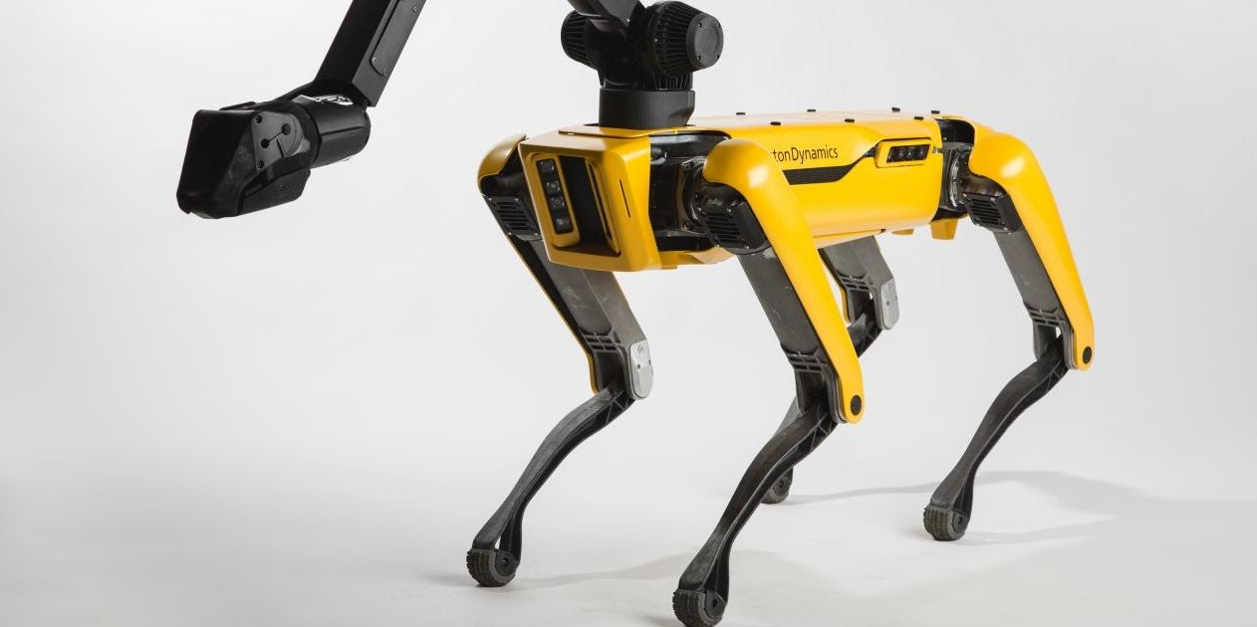
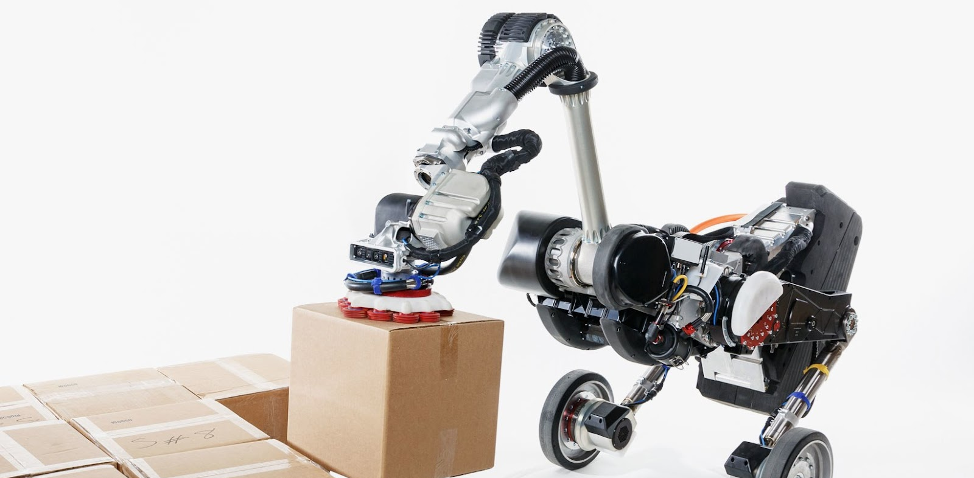
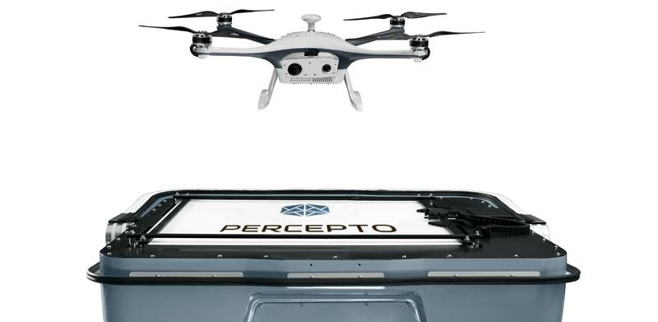
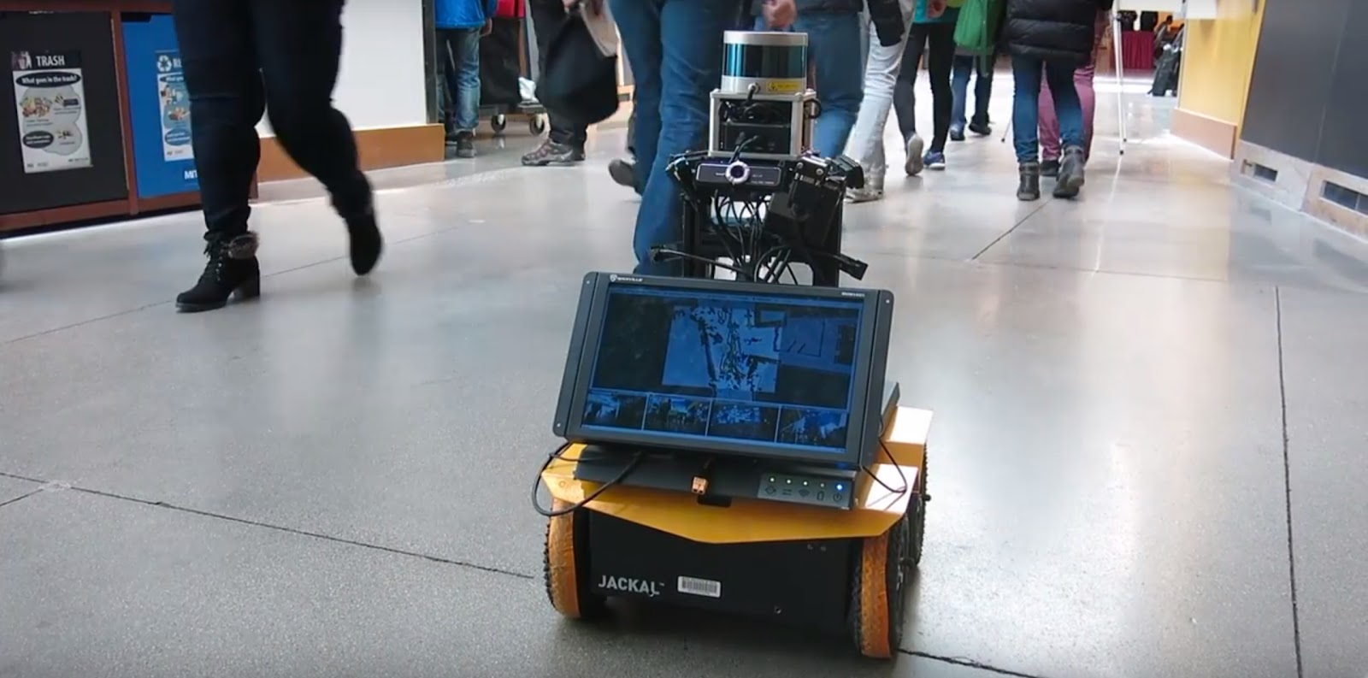
2.2 Autonomous Technology ~ Different degrees of automation in industry
A. Spotmini - Boston Dynamics A dog-like robot which helps in basic tasks like opening doors, picking objects, climbing stairs etc. Context - In offices, homes and outdoors.
B. Handle - Boston Dynamics A robot that handles logistics like managing boxes like picking, stacking, loading/unloading etc. with agility. Context – warehouses
C. Sparrow – PerceptO It takes off from its base, performs assigned tasks, and returns to charge and transfer data to cloud storage upon completion of the mission.
D. Jackal : A tiny social robot that can walk among us just like other humans, and people found it ‘cute’

Slide 17
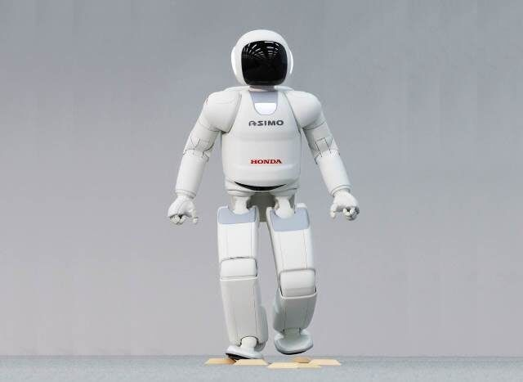
2.2 Autonomous Technology ~ Different degrees of automation in industry
E. Asimo – Honda A tiny social robot that can walk among us just like other humans, and generated familiarity due to human like shape
F. Pepper – Healthcare bot A short heighted healthcare bot used in hospitals. Short height makes them less threating

Slide 18
2.2 Autonomous Technology ~ Popular Use Cases
Based on the landscape analysis in various domains aligning with Siemen’s business vertical, 6 major use case scenarios were identified
Decision making
On behalf of humans
High Risk Factor
High risk of human lives
Uncertain environments
Complex systems
Assisting
Manual labor and physical work
Hyperpersonalisation
Of tasks/content based on context/usage/ variable need
Relieving from Procedural tasks
Open scope for other interactions that demand human intellect & understanding

Slide 19
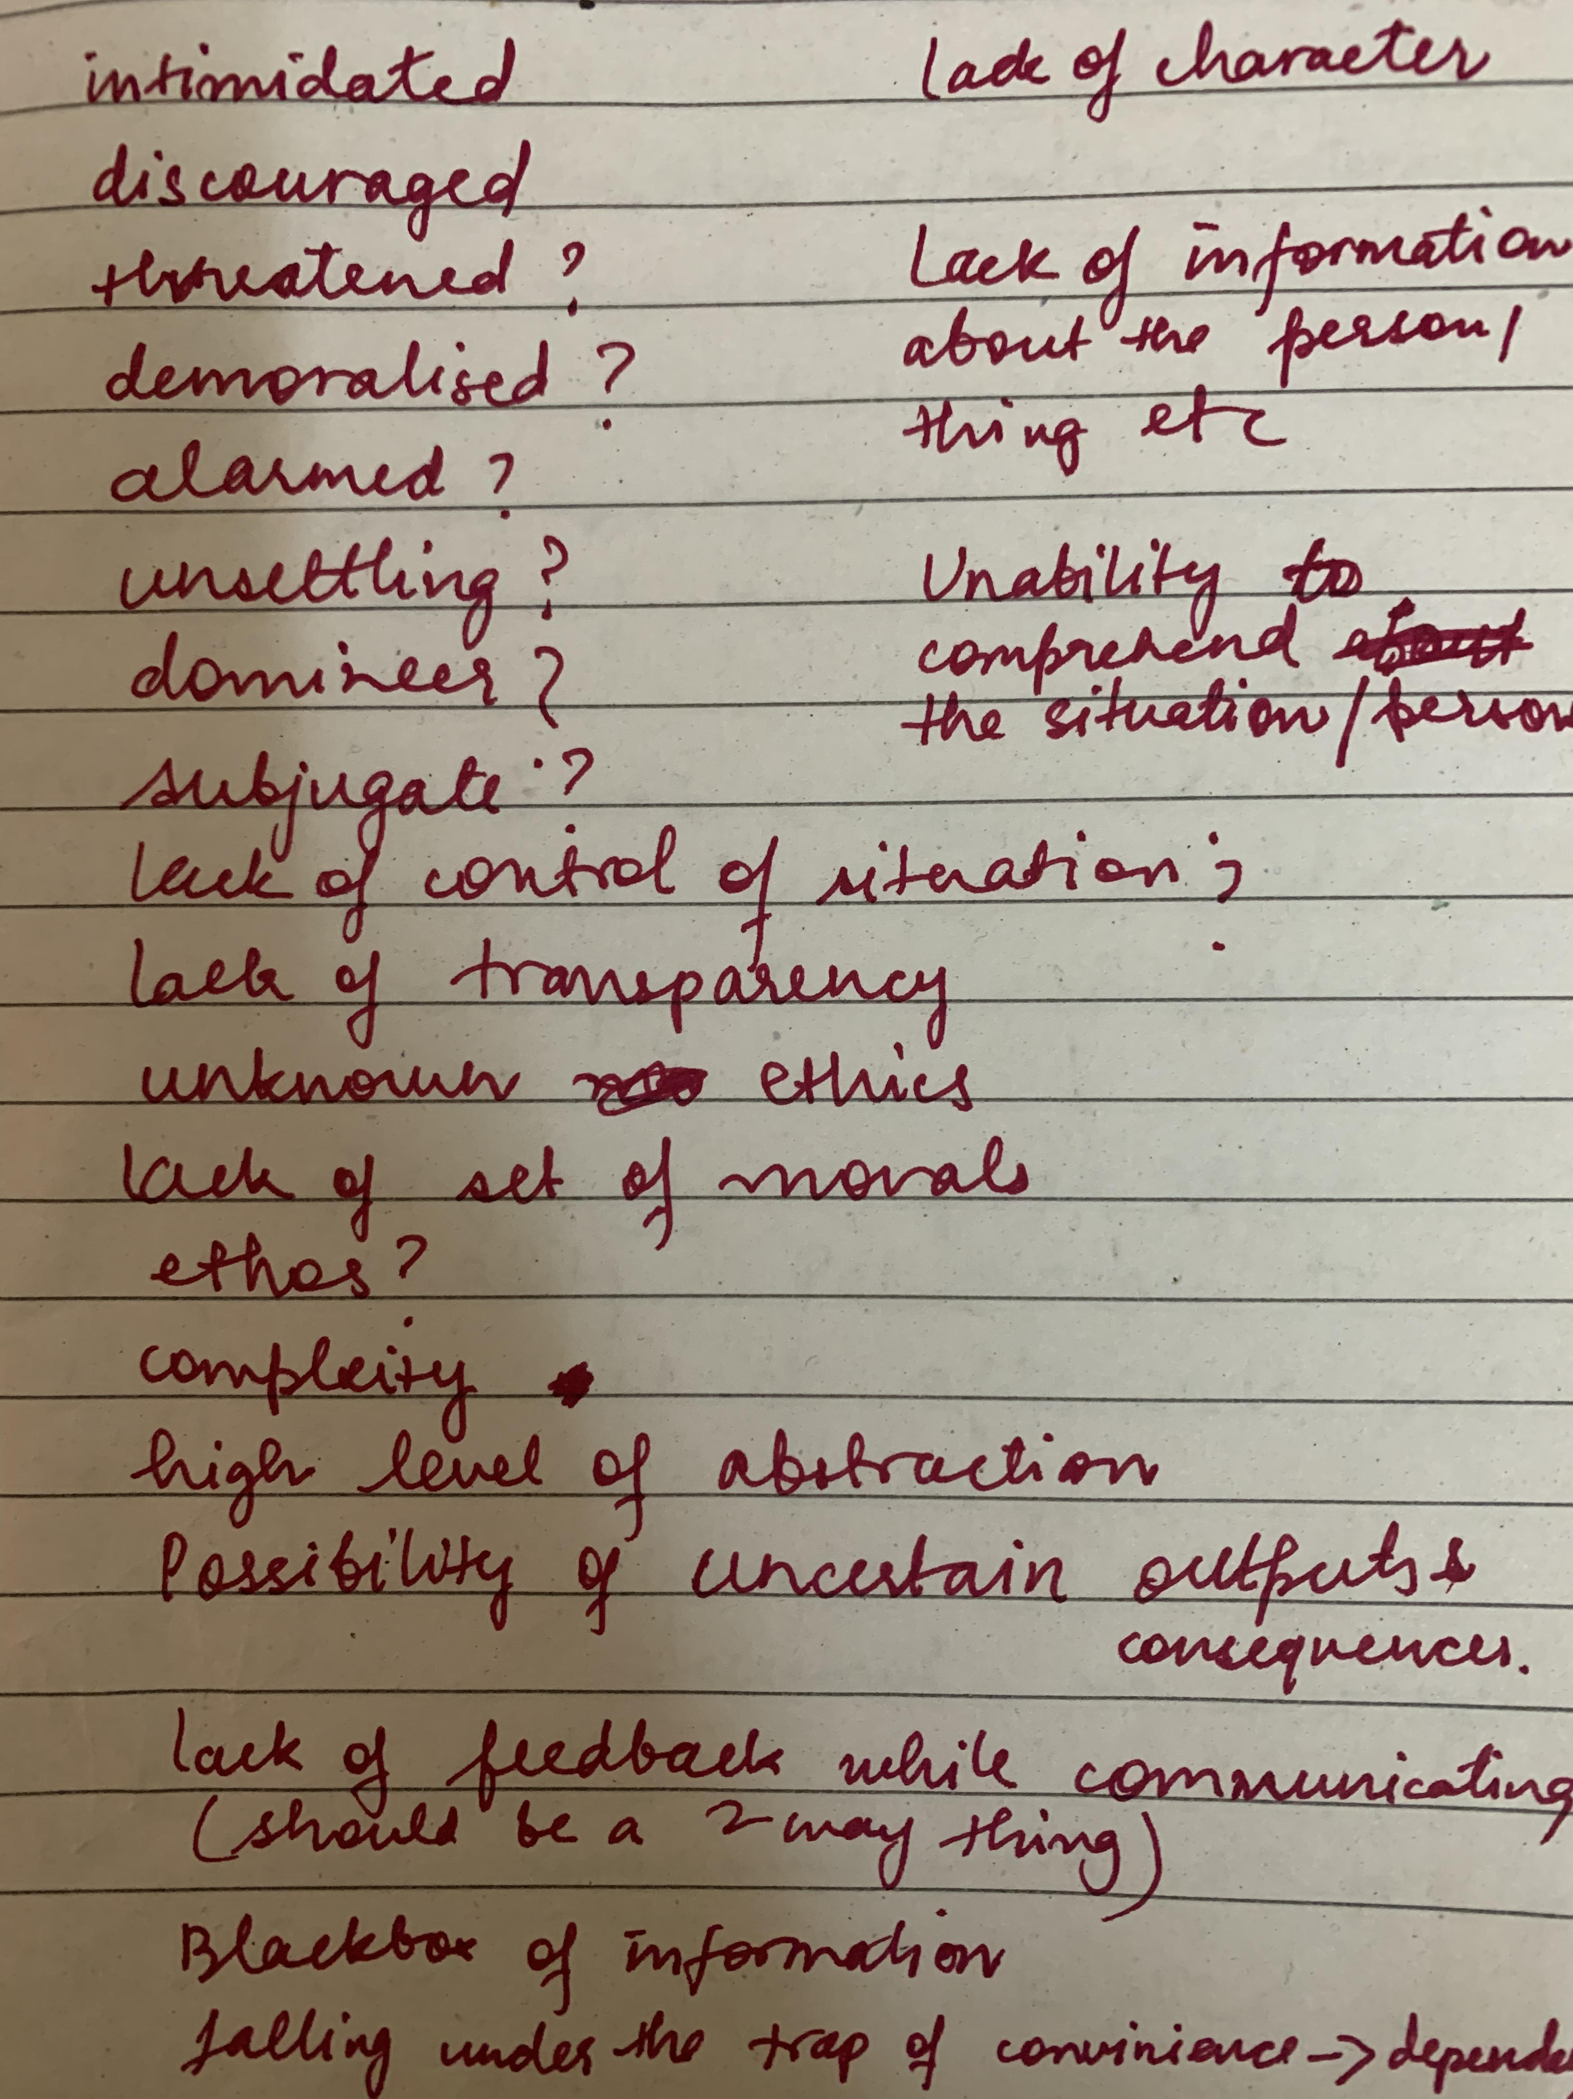
2.2 Autonomous Technology ~ Voice of People
The secondary study also aimed to understand human sentiments surrounding this technology via online VOCs and talking to people around, which are familiar with the theoretical concept of the technology, not necessarily experienced it.
Intimidated
Uncertainty
Threatened
Lack of feedback
Unsettled
Lack of character
Lack of control
Unknown morals
Lack of transparency
alarming
Unknown ethics
complex
abstraction

Slide 20
2.4 Expert Interview
Primary research
To understand the process of creation of Autonomous systems in-house at Siemens, expert interview were conducted with Research Engineers currently working on Level 2 Autonomous guided vehicles. The interview was conducted like a discussion to better understand the procedures, rules, guidelines that are used by the autonomous systems teams as there was no prior knowledge about it
Expert Profile 1 Designation : Senior Research Engineer
Expertise : Reinforcement Learning
Group : Autonomous Systems Group
Expert Profile 2 Designation : Lead Research Engineer
Expertise : Reinforcement Learning
Group : Autonomous Systems Group
Process of creation
Key Learnings
Perception
Obstacle detection and removal; humans considered as obstacles
Human safety of foremost importance
Lack of human interaction is expected and favored as human behavior is uncertain around technology, they don’t understand people’s
skepticism and discomfort for the interacting with autonomous technology
Humans are considered obstacles during the process and the plan is to immobilize and wait till the human moves out of the ecosystem
Planning
If obstacle/human detected, then immobilization & plan detour
Control
Take action based on plan

Slide 21
2.5 Research analysis ~ summary
EXPERT INTERVIEWS
It is observed that human being are categorized at obstacles and due to high concern for safety, the interaction with humans is minimized or eliminated in the current use cases being worked upon. There is low focus on interaction with humans being and co-existing in the same environment.
LITERATURE REVIEW
The autonomous ecosystem is rapidly marching towards higher levels of autonomy. It is observed that Autonomous Systems are closer in vicinity to human being that expected. The technology, even at a nascent stage is expecting higher adoption in various use cases that involve human being. Moreover, the current use cases have autonomous agents which have very low autonomy. Therefore, the level of human engagement and interaction cannot be eliminated.
‘The current process of creation of autonomous tech at Siemens aims to minimize human interactions’
‘Impossible to eliminate human interaction in the transitional phase of this technology’

Slide 22
03. The Problem

Slide 23
3. Problem in focus
1
Due to the transitional nature of Autonomous Technology, Humans and Autonomous Systems need to coexist in closer vicinity than what was assumed.
2
Current approach of creation of Autonomous Systems invoice minimizing human interactions and eliminating humans from the loop.
As we put highly complex systems in human environment with high human interactions, there’s less focus on making these systems acceptable to humans and the experience more pleasant. The transition to ubiquity of autonomous systems is rapid and not at pace with the rate at which humans are getting comfortable with it. This unease, discomfort and scepticism in working together can result in friction in workflow and realization of true potential of autonomous systems.

Slide 24
04. The Opportunity

Slide 25
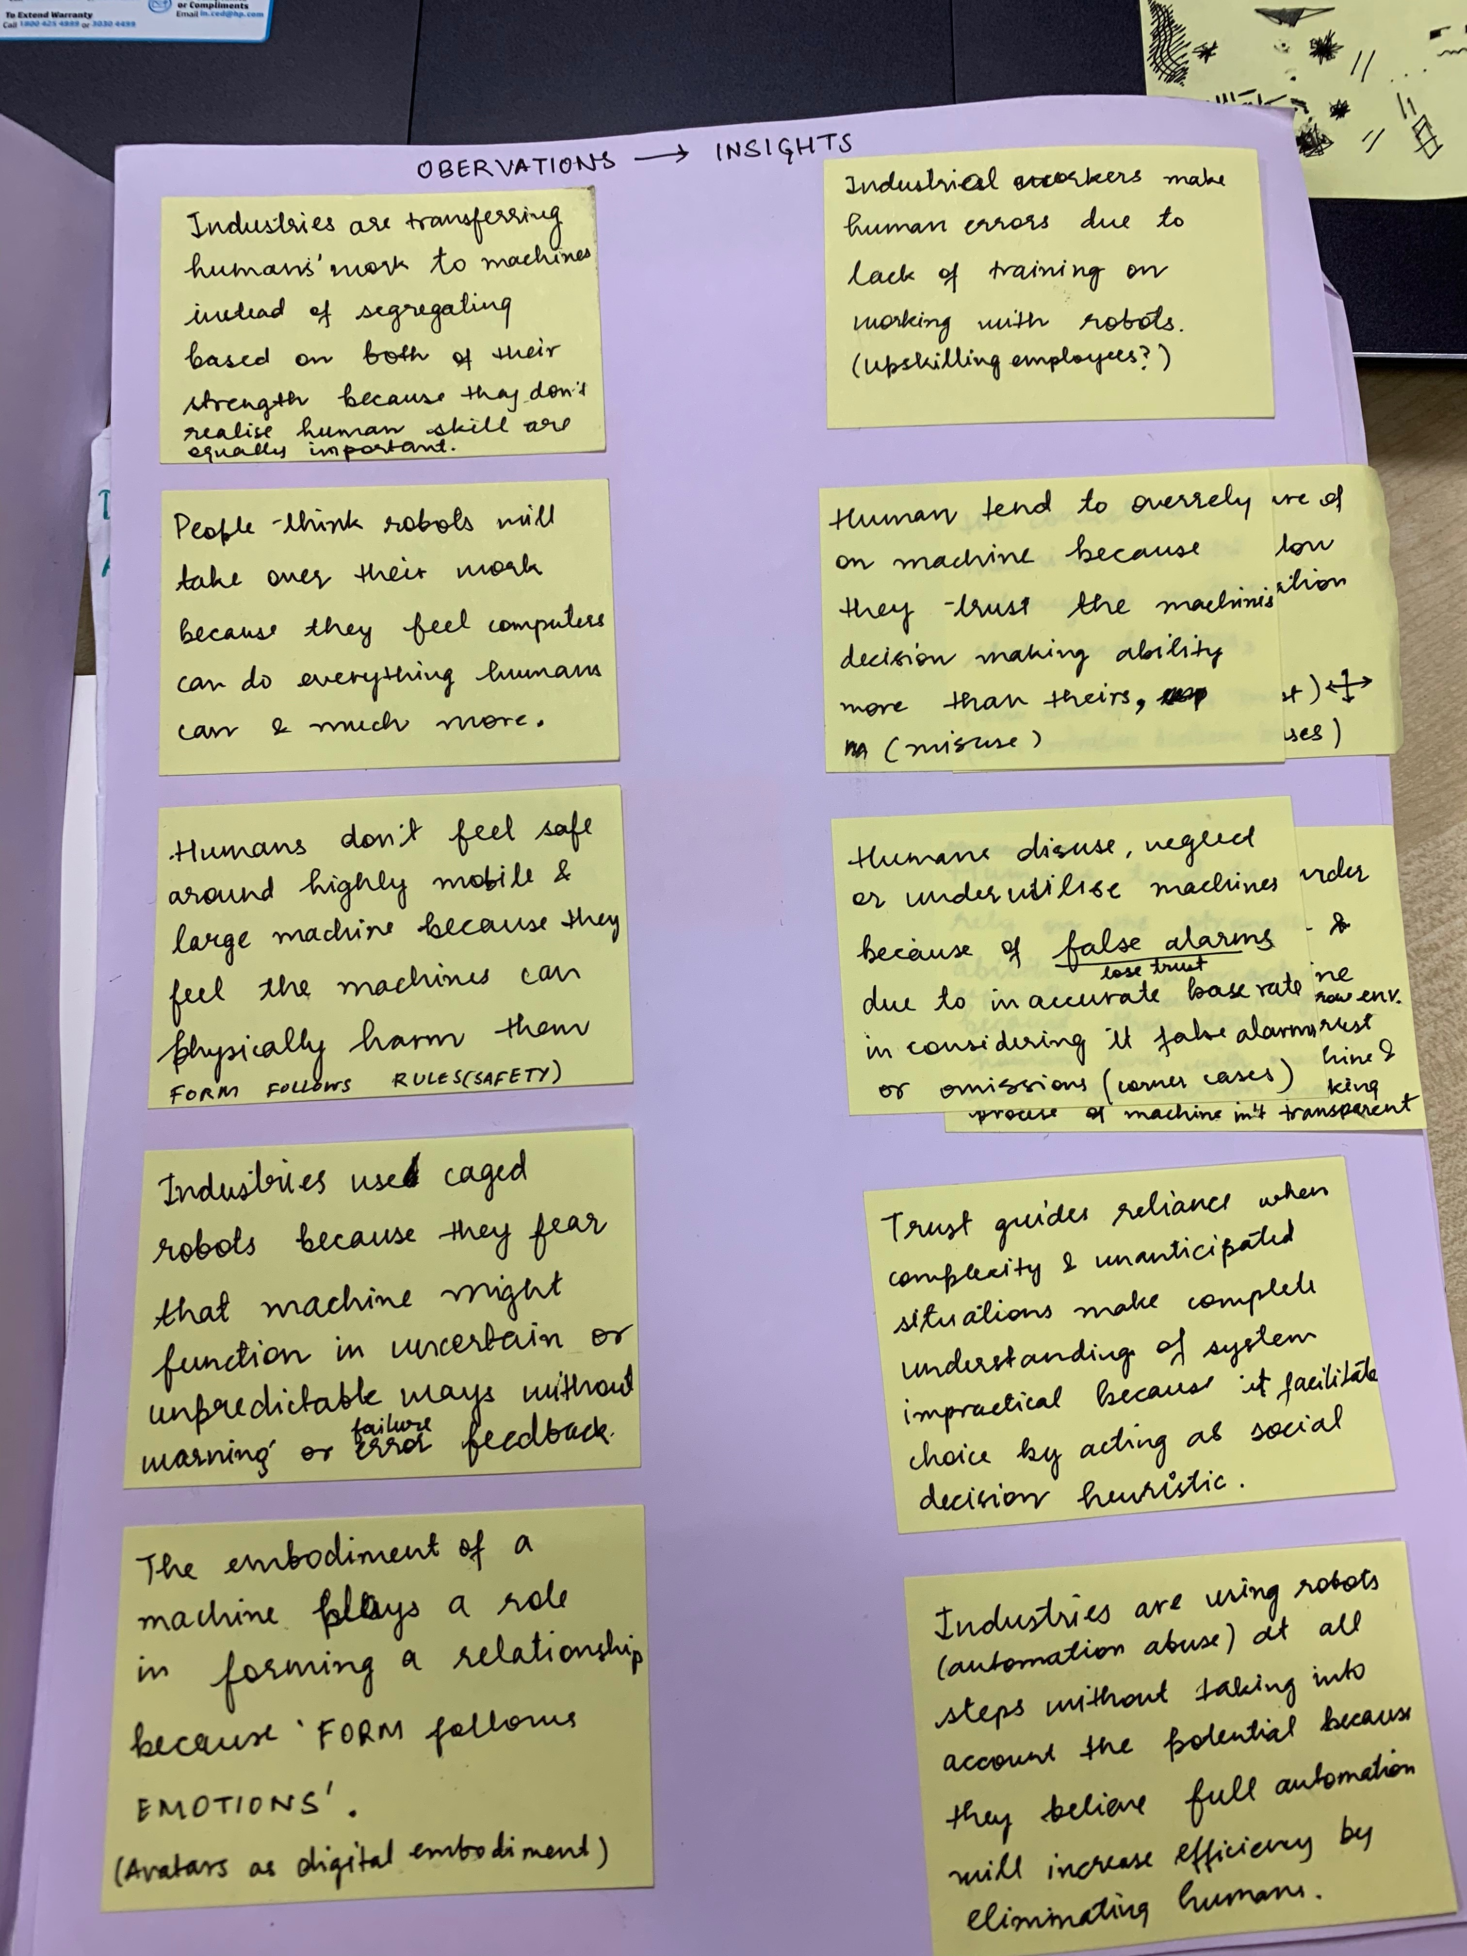
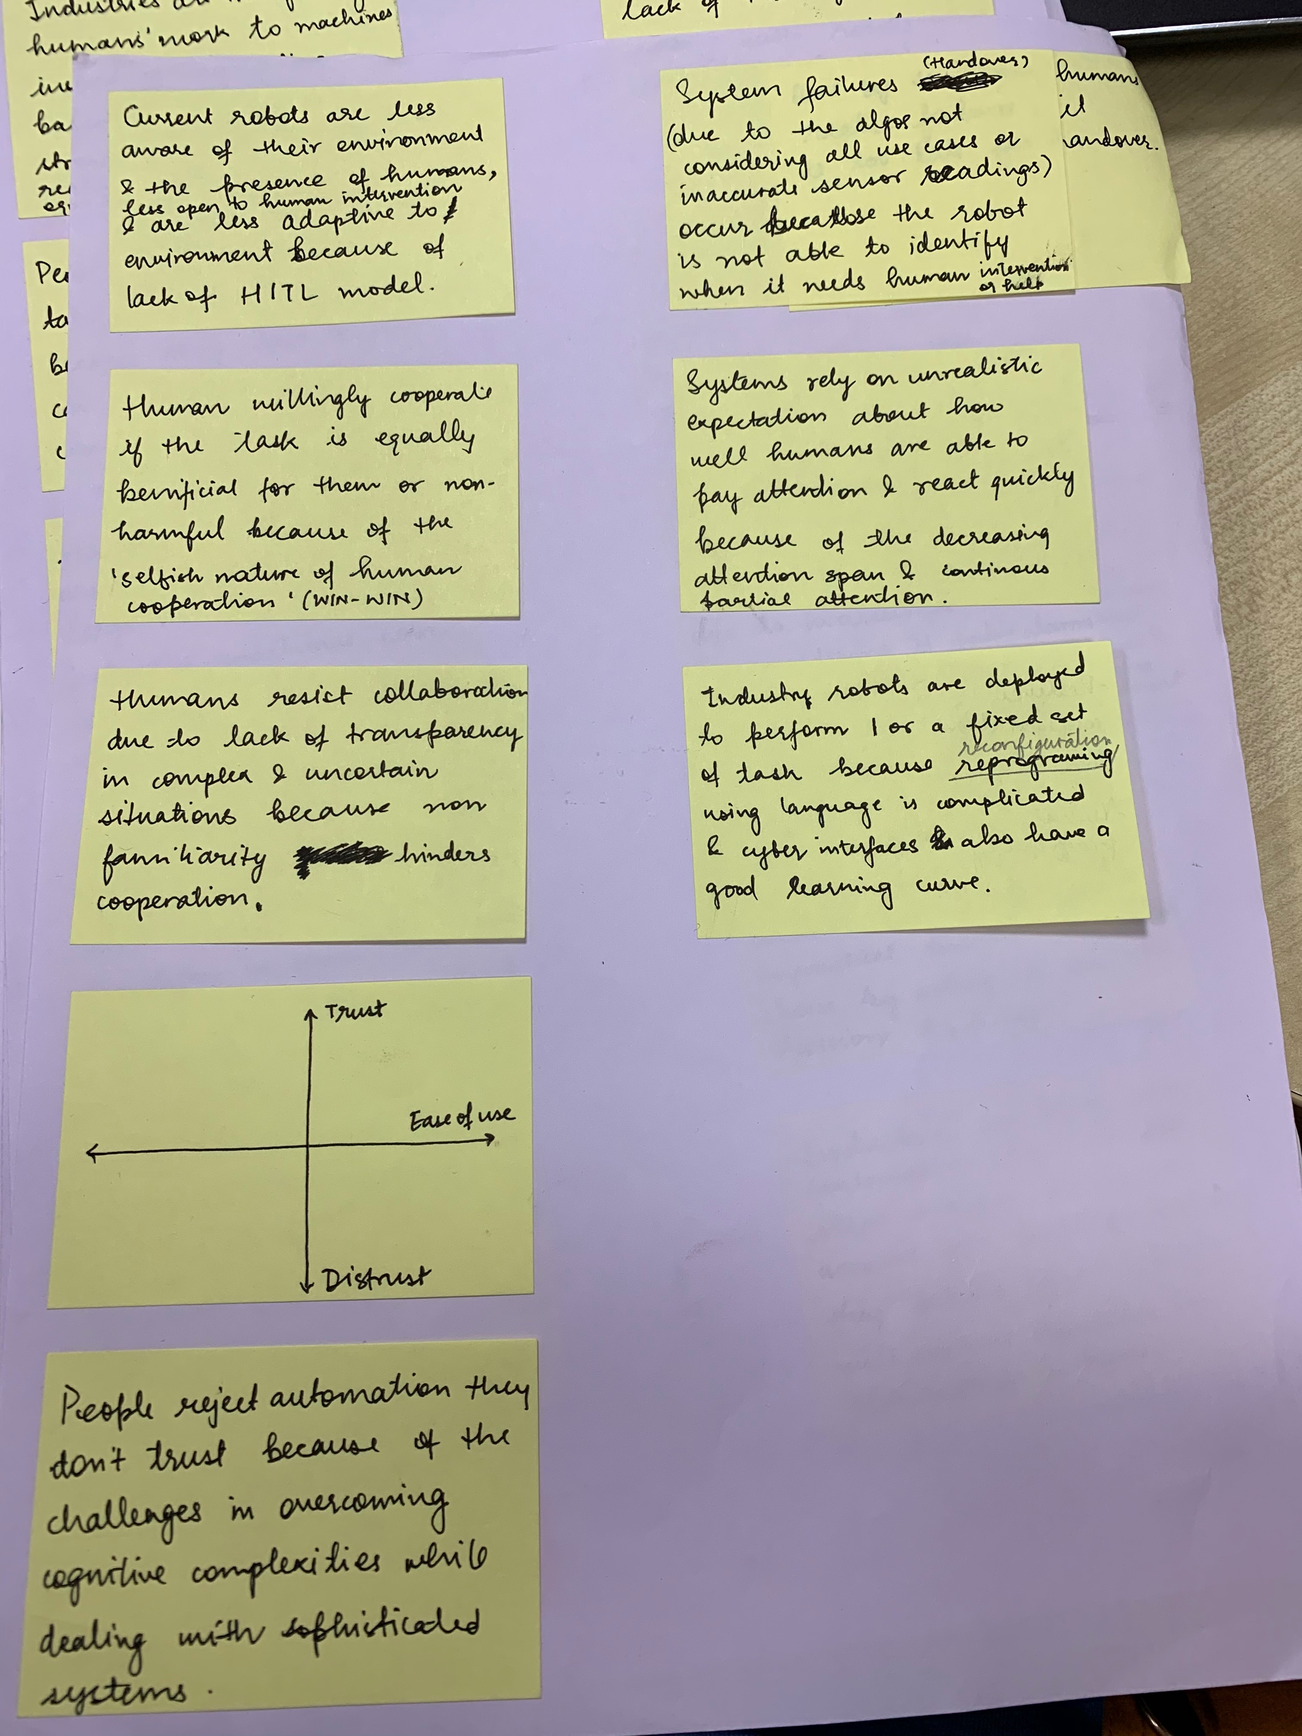
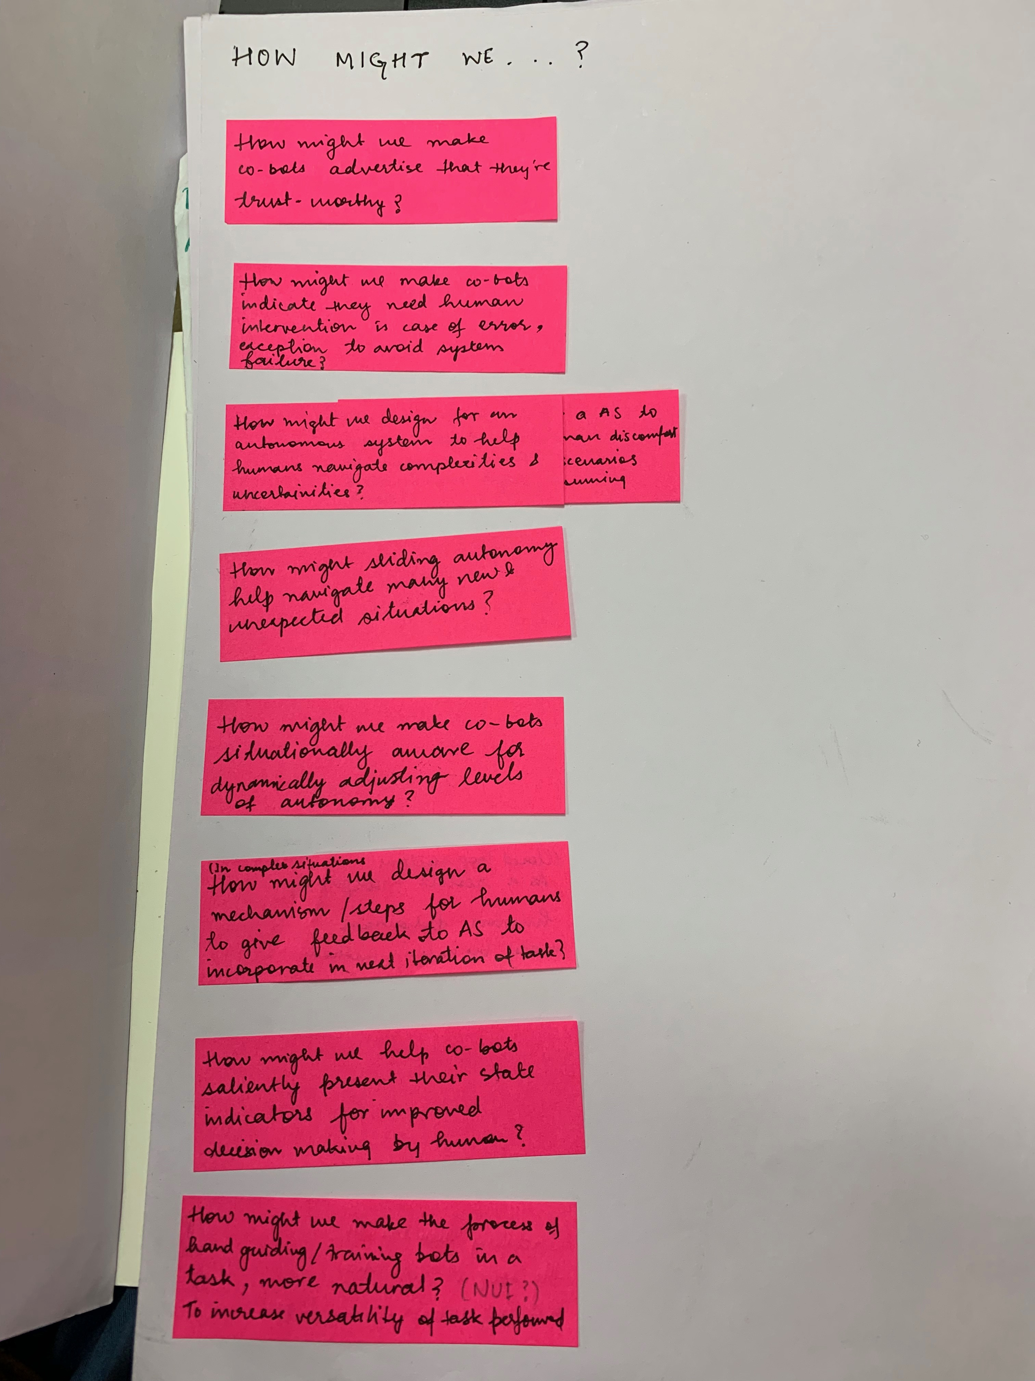
4. Opportunity mapping
Figure 5. Translating Observations into Actionable Insights by creating ‘How might we statements’

Slide 26
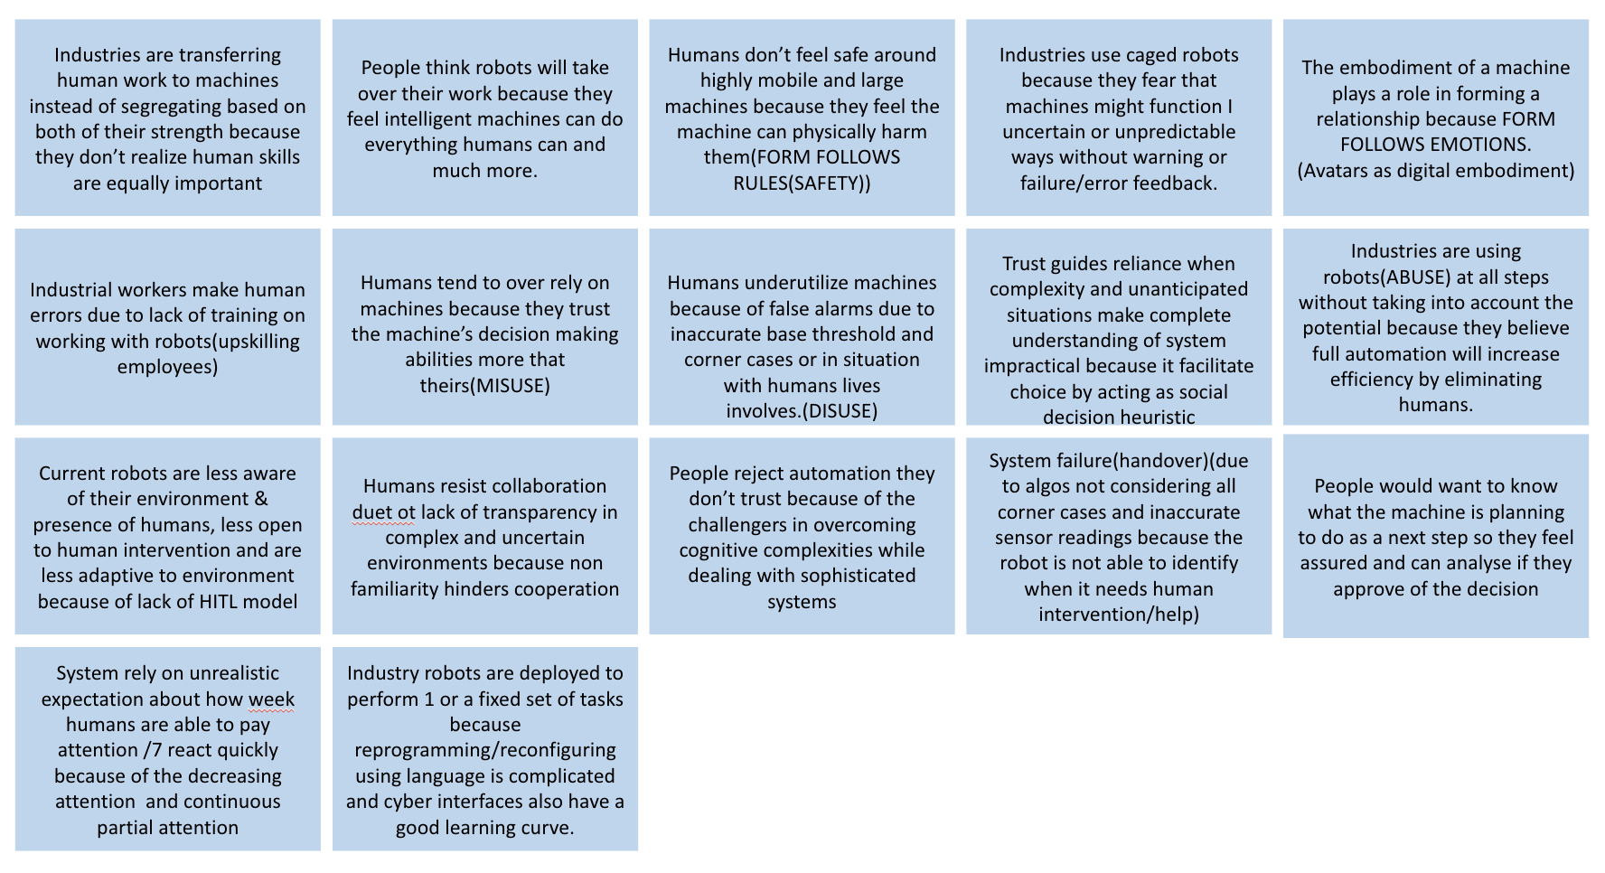
4.1 Identifying opportunity ~ Key observations till now

Slide 27
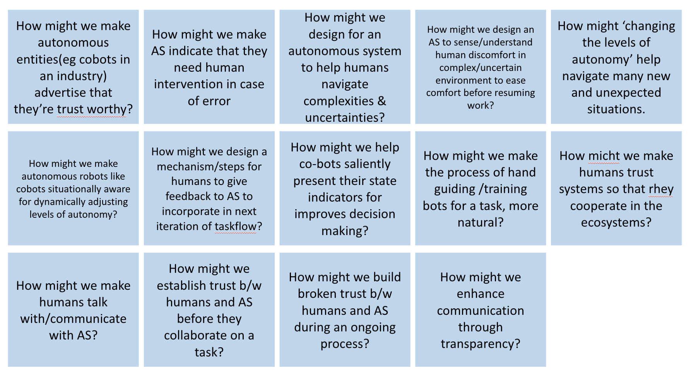
4.1 Identifying opportunity ~ Actionable Insights

Slide 28
4.1 Defining objective for further research
Looking from the lens of Siemens business, reducing friction
between humans and autonomous system facilitate the ubiquity of Autonomous Systems in various domain of their business.
Looking through various lenses solidified the project’s future direction to work in the domain of collaboration. From merely co-existing with Autonomous Systems, there is a bigger design opportunity for Humanizing Collaboration with Autonomous Systems.
From co-existence to collaboration
After observing the how might we statements, collaboration same out as an objective for future research
As humans co-exists with autonomous systems in close vicinity, due to the uncertain and complex nature of human being, its is important to expect human interactions with Autonomous Systems, direct or indirect, intentional or unintentional. To navigate those scenarios, it is important for humans and autonomous systems to be able to work in collaboration to achieve that goal. At the transitional level of this technology, the nature of such encounter will can be in different landscapes and of varied degree. Therefore, merely co-existing without interactions and collaborative ecosystem will create frictions in the ubiquity of Autonomous System and will increase discomfort and skepticism around the technology.
Looking from a scientific lens, the evolutionary roots of human collaboration lies in the ability to achieve otherwise inaccessible goal and its contribution to their success as a species. Considering the theory, it is interesting to consider that evolution might be more about collaboration than competition.

Slide 29
5. New Design Brief

Slide 30
5.1 New Design brief
“
How can we humanise collaboration with autonomous systems ?
As we try to achieve full autonomy of machines, identify the role design can play in the domain of autonomous system.
As we try to achieve full autonomy of machines, what role can design play in the domain of autonomous system?
”

Slide 31
5.2 Methodology
After identifying the objective for Phase 2 of the project, the brief is redefined along with defining the nature of deliverables expected from the project.
DELIVERABLE & METHODOLOGY
Create a framework for collaboration that can be applied to different kind of autonomous systems. A top-down approach was taken for the framework so that it can be applied across business domains and then specialized for specific domain by iteratively integrating domain specific parameters.

Slide 32
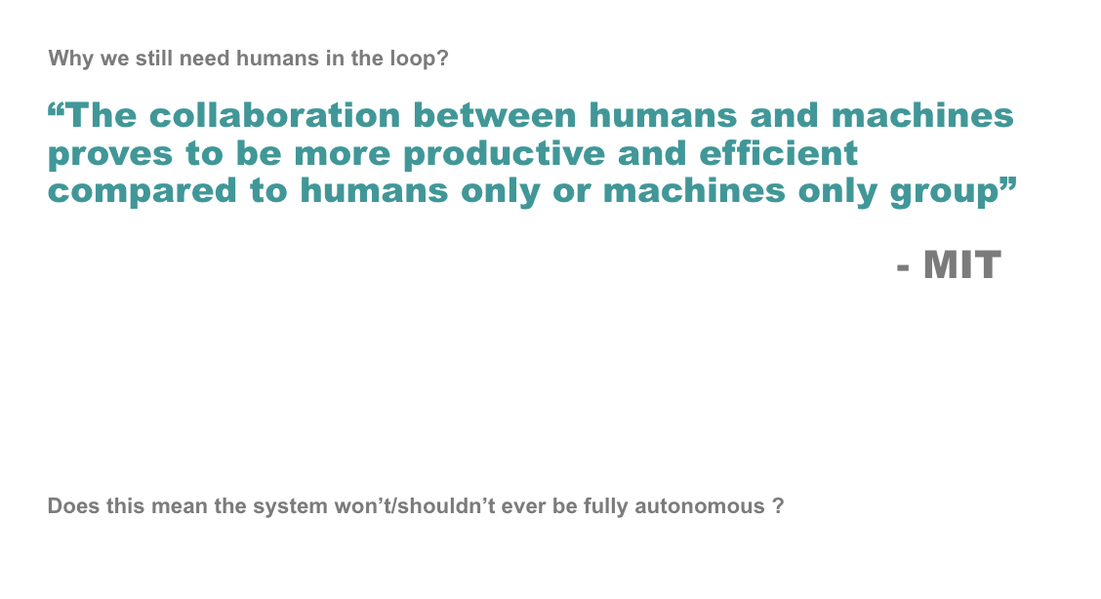
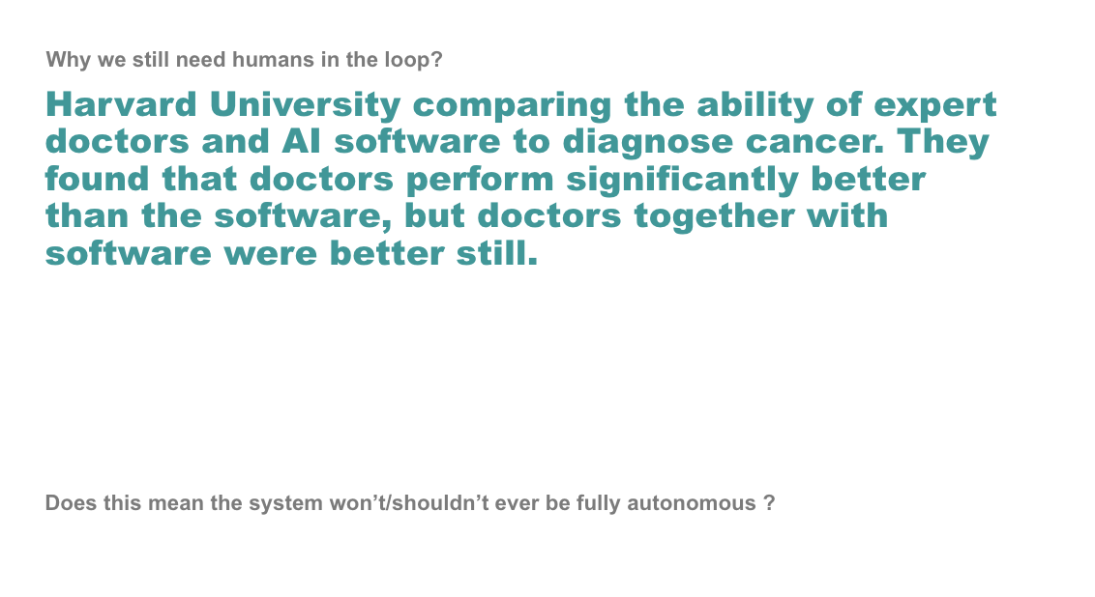
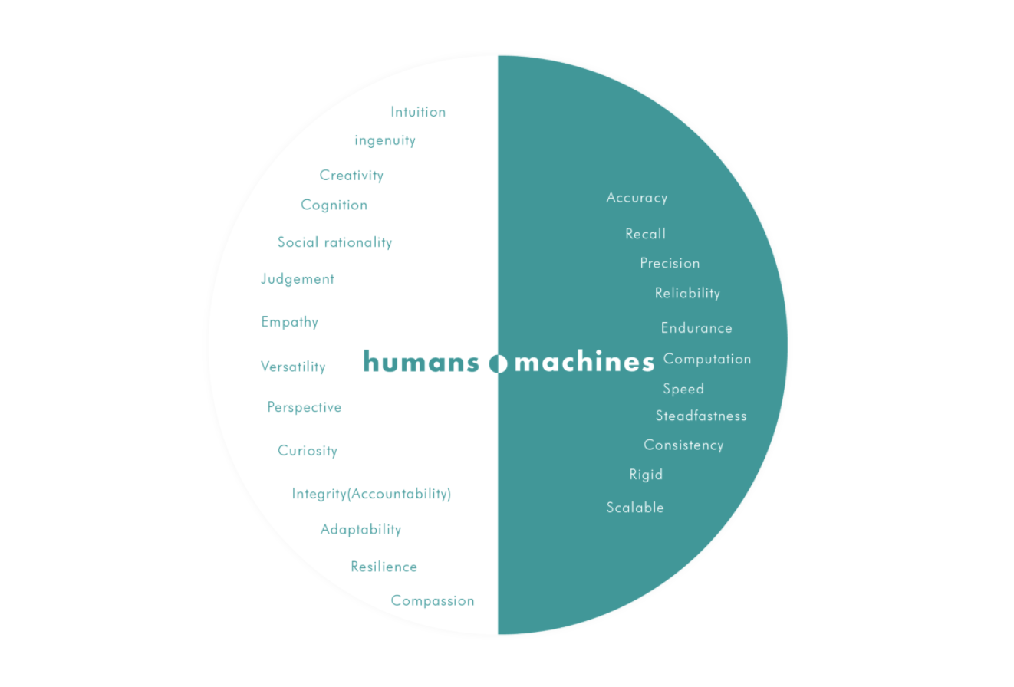
5.2 Understanding Collaboration ~ Industry examples of success
Figure 6. Unique capabilities of human and machines

Slide 33
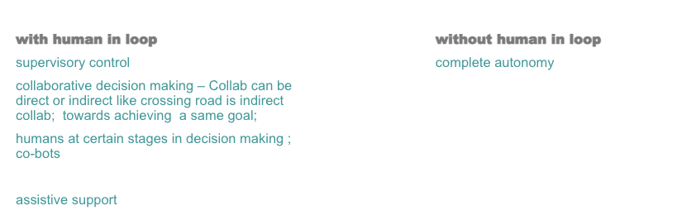
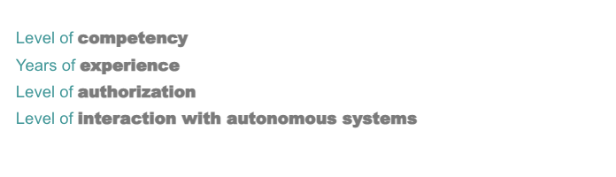
5.2 Understanding Collaboration ~ What
We define collaboration as the process of two or more people, entities or organizations working together to complete a task or achieve the same goal.
Collaborative autonomy characterizes how individuality (autonomy) and. collaboration (ecosystem construction) co-evolve. Collaboration appears to. be a basic dynamic, in both the evolution of life and the emergence of intelligence[6]. As in evolution, individual differences are critical, so also Innovation (or Knowledge) Networks link participants, maintaining their uniqueness and collaborative autonomy such that knowledge can evolve as networks grow, with potential for emergent, unpredictable patterns and innovative outcomes manifesting collaborative intelligence.
While understanding collaboration and technology in human ecosystems , its is important to recognize various socio-technical systems around us. Sociotechnical systems in organizational development is an approach to complex organizational work design that recognizes the interaction between people and technology in workplaces. The term also refers to the interaction between society's complex infrastructures and human behavior. For e.g. : Facebook is a socio technical system
It is critical to note that humans in socio technical system perceive technology via a social lens. As per the Media equation The Media Equation is a general communication theory that claims people tend to assign human characteristics to computers and other media, and treat them as if they were real social actors. This is critical in understanding human being collaboration style which might may show similarities with human-human collaboration
Post identifying collaboration as an opportunity, further research uncovers on going work in the domain of Collaborative Autonomy which is still at a very nascent stage.
Humans around autonomous systems
Humans around autonomous systems

Slide 34
5.3 Understanding Human & AS together ~ The Friction
use
misuse
disuse
abuse
the voluntary activation or disengagement of automation by human operators
overreliance on automation, which can result in failures of monitoring or decision biases.
the neglect or underutilization of automation
or the automation of functions by designers and implementation by managers without due regard for the consequences for human performance, tends to define the operator's roles as by-products of the automation
Areas of concern
Figure 1. Flawed relationships between humans and machines
‘People fail to appropriately rely on automation’

Slide 35
6. The Framework

Slide 36
6.1 Framework for Humanizing collaboration with Autonomous System
Based on the understanding from the research on collaboration and aligning with the business domains of Siemens, a framework is proposed to humanize collaboration with Autonomous Systems.
The framework focuses on Dyadic collaboration i.e. between 2 parties. The pillars of the framework work in tandem i.e. There are different ways to approach/design for these factors which will result in different collaboration styles in different situations. Different domains/business will demand different ways to approach these factors with different prioritization. However, the way the first pillar is approached will affect what factors and parameter of other pillars are applicable and how to approach them. It might also happen that certain domains demand more focus to certain pillars more than other. This approach hasn’t been explored in the scope of current project
The best way to approach the framework to humanize collaboration in a domain –
Select a business domain
Based on the domain, prioritize the pillar that need to be worked upon first.
Based on the domain, each pillar will be approached differently, which will affect the decision to choose the next pillar and what all parameter are to be considered.
Iteratively moving on all 9 pillars will create a collaboration style that is unique to the domain and the use case for which it is deployed.
Domain 1
Domain 2
Collaboration Style 1
Collaboration Style 2

Slide 37
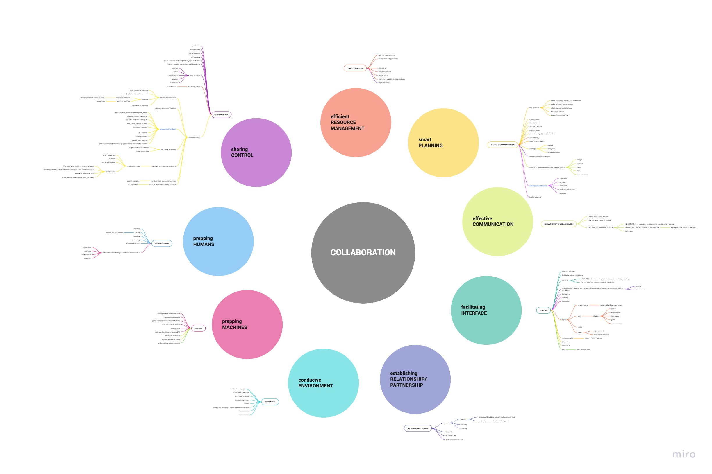
Figure 1. Framework for Humanizing collaboration with Autonomous System

Slide 38
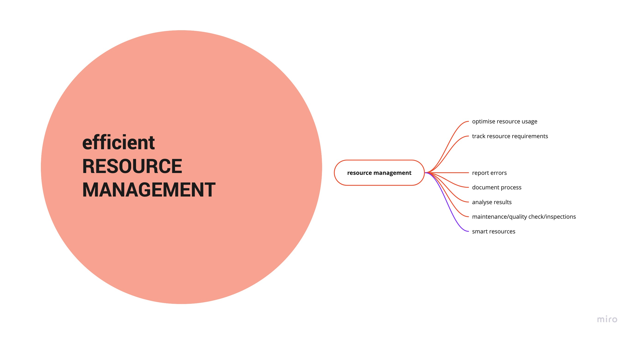
6.3.1 Pillars of the Framework ~ Efficient Resource Management

Slide 39
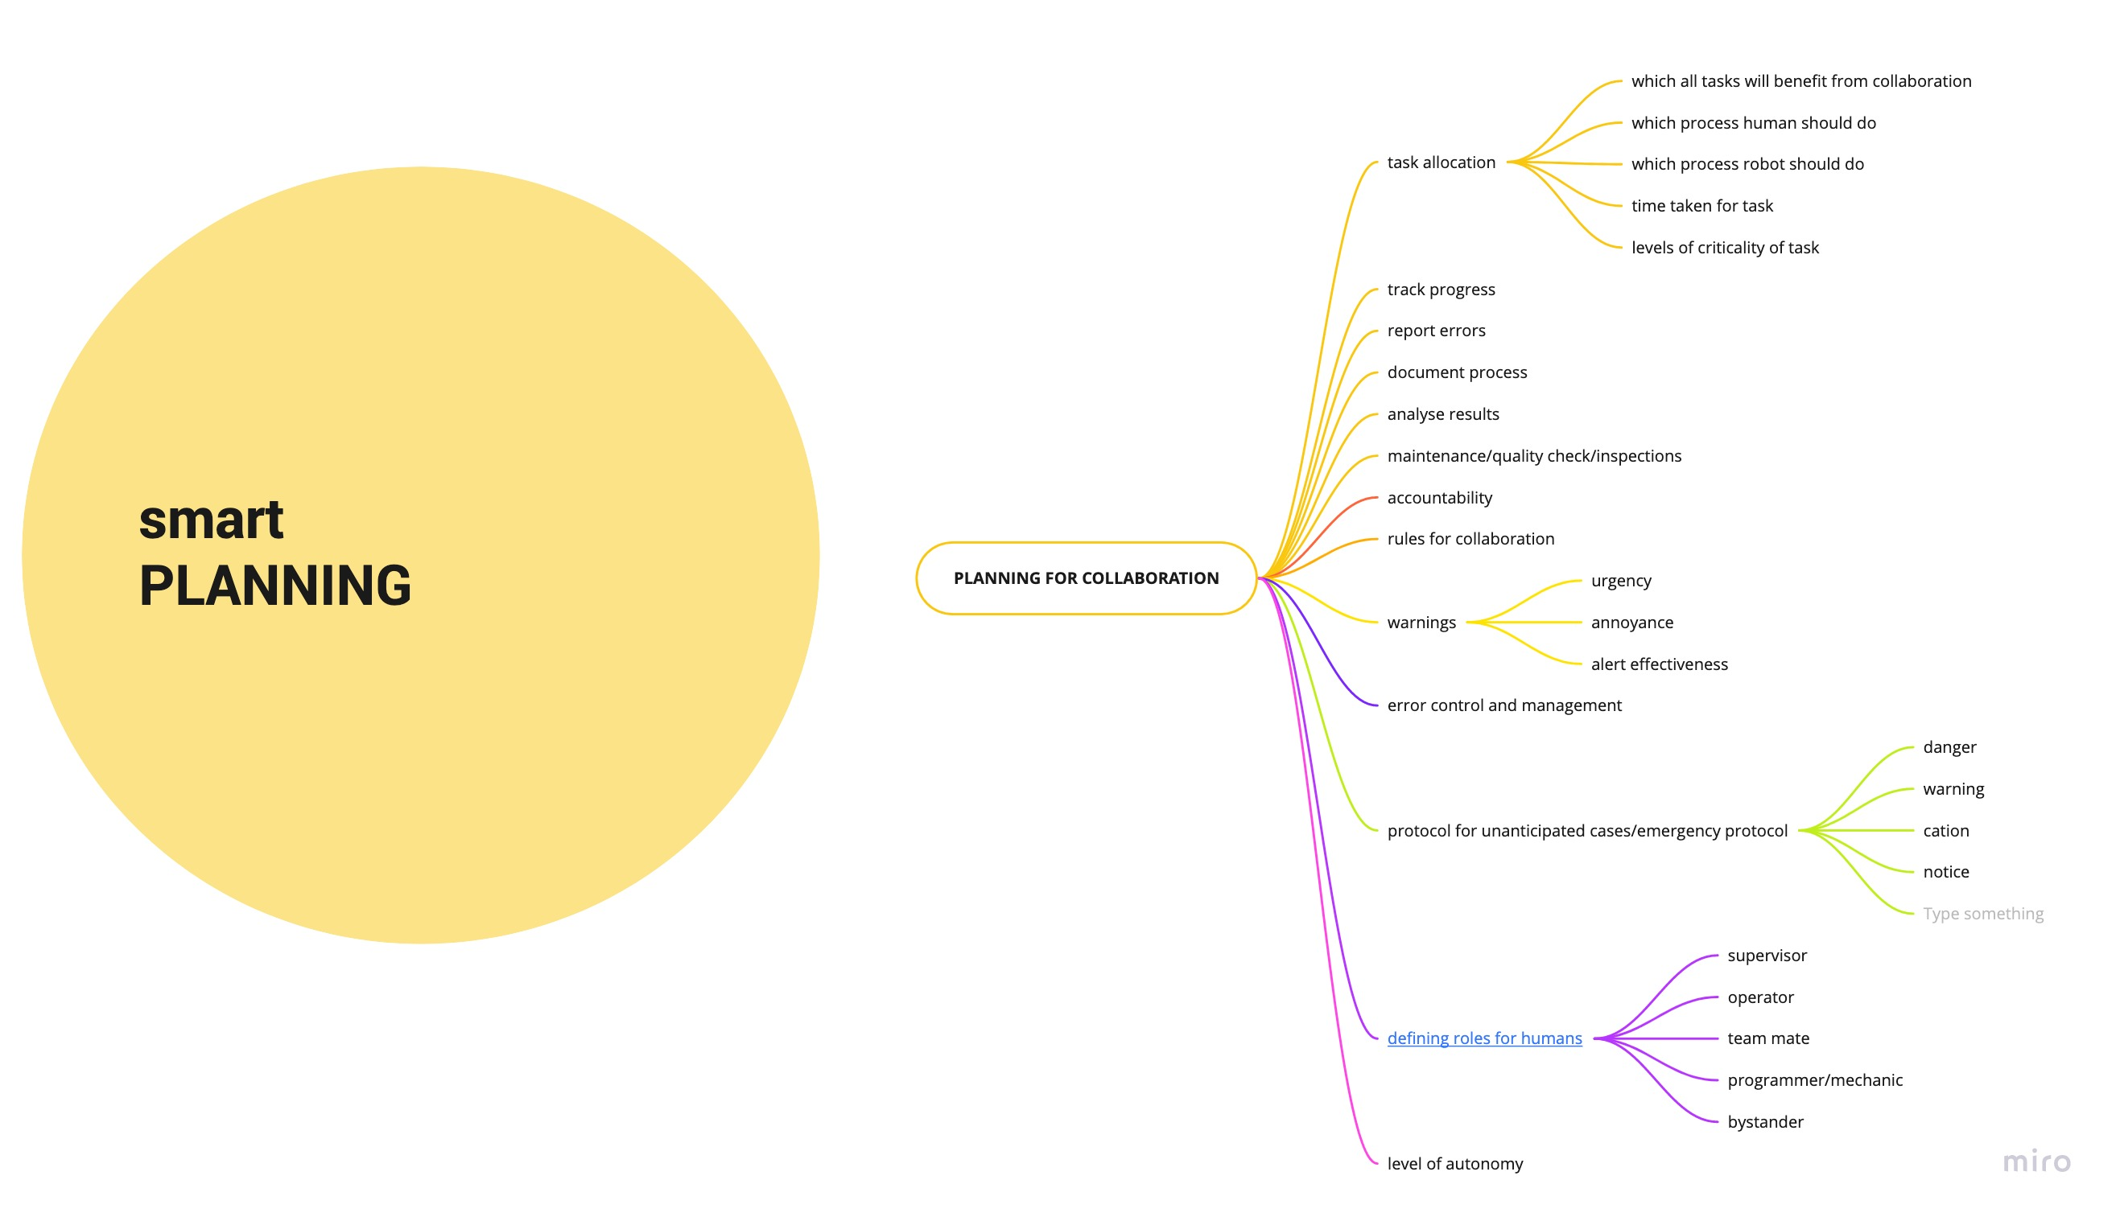
6.3.2 Pillars of the Framework ~ Smart Planning

Slide 40
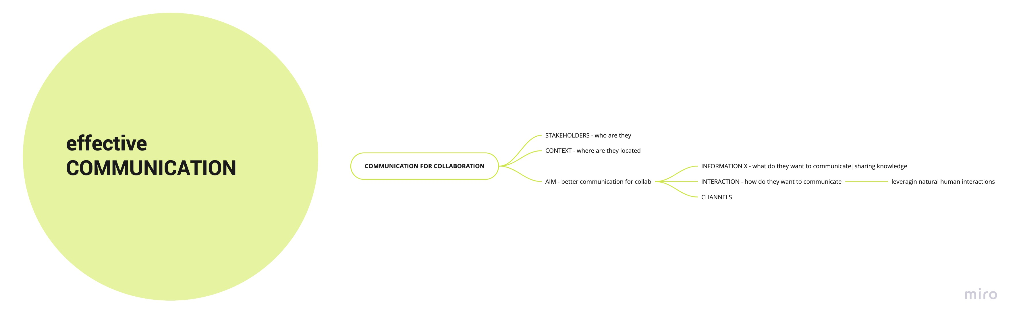
6.3.3 Pillars of the Framework ~ Effective Communication

Slide 41
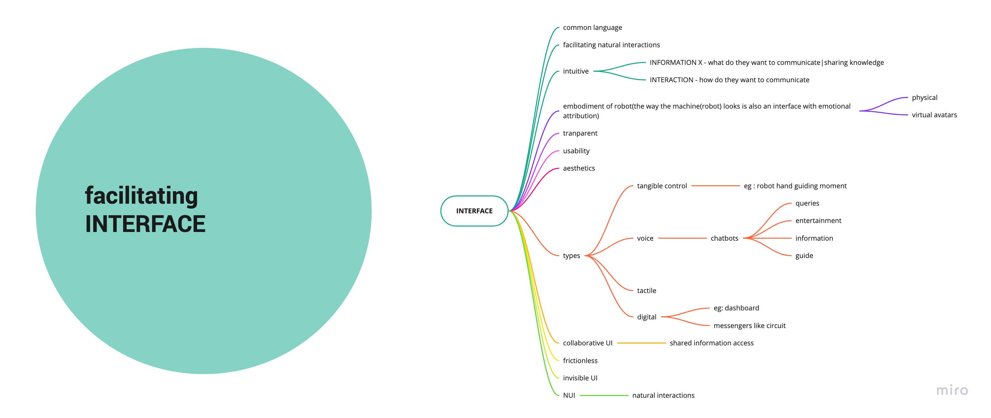
6.3.3 Pillars of the Framework ~ Facilitating Interface

Slide 42
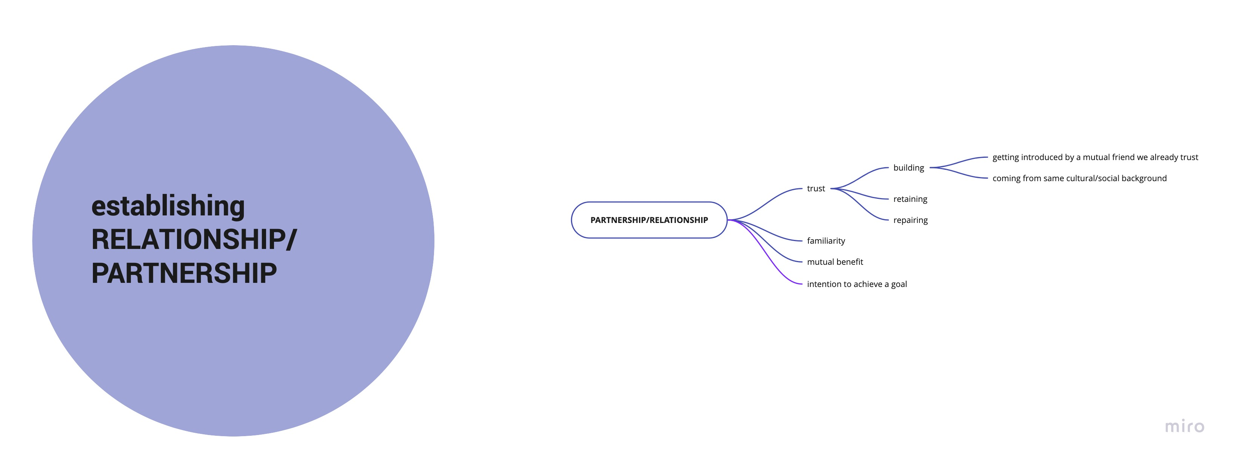
6.3.4 Pillars of the Framework ~ Establishing Relationship/Partnership

Slide 43
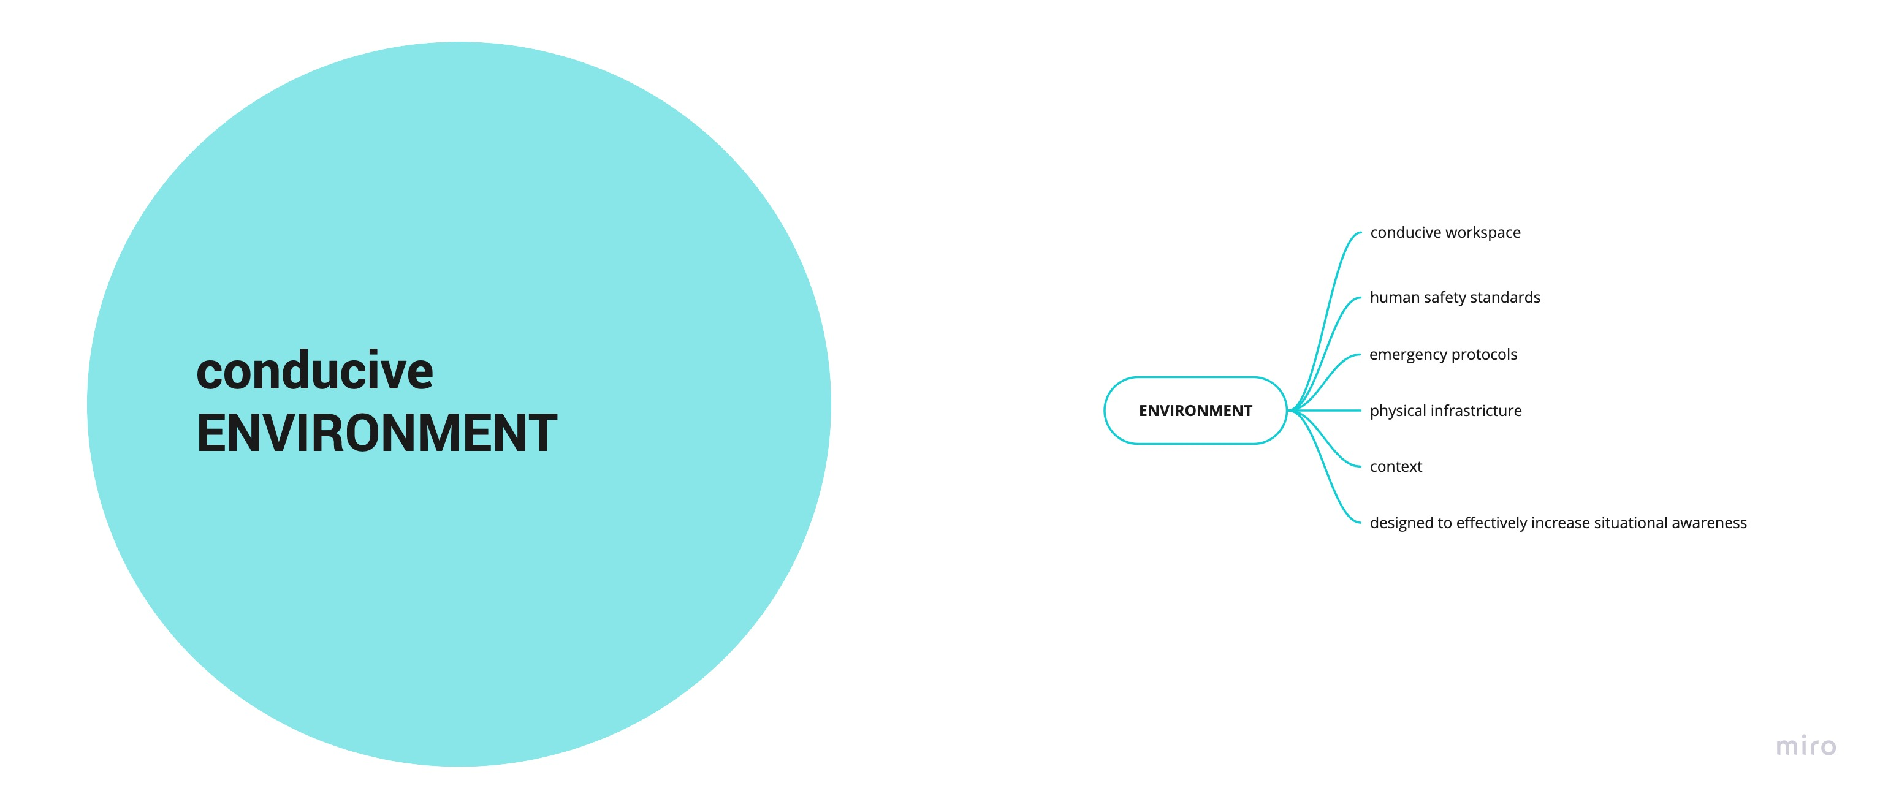
6.3.5 Pillars of the Framework ~ Conducive Environment

Slide 44
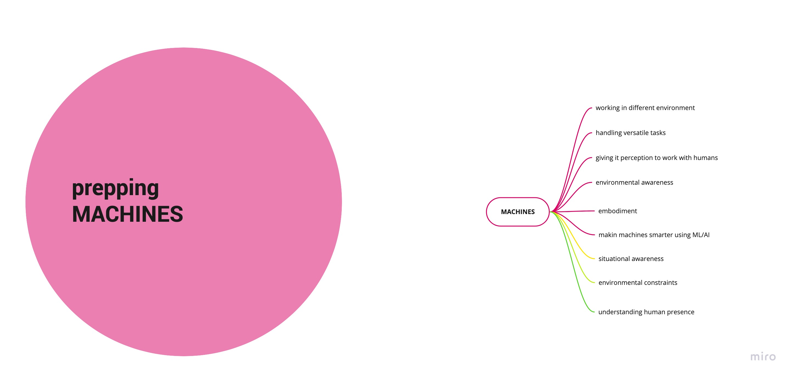
6.3.6 Pillars of the Framework ~ Prepping Machines

Slide 45
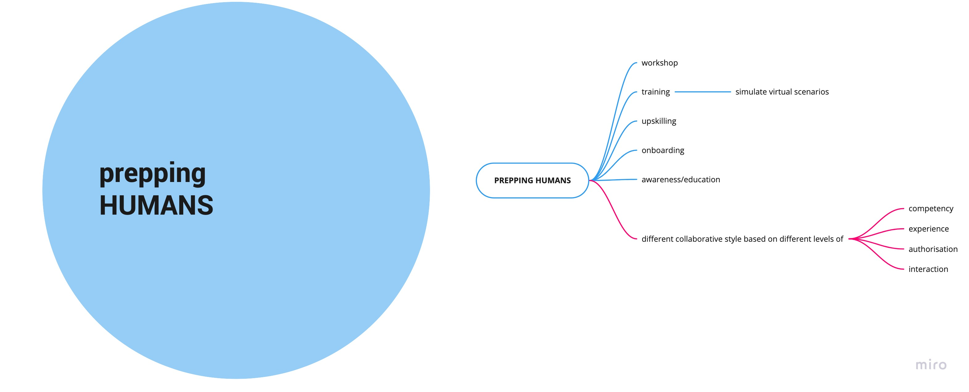
6.3.7 Pillars of the Framework ~ Prepping Humans
How will they collaborate with AS?
How to approach the framework what qualities of humans and AS are strong which can be combined as a successful concotion of a successful collaboration
Media equation
Based on Siemens business, a framework is proposed to humanize collaboration with Autonomous Systems.
The framework focuses on Dyadic collaboration i.e. between 2 parties.
Different ways to approach/design fro these factors will result in different collaboration styles in different situations.
Different situations will demand different ways to approach these factors for efficient results

Slide 46
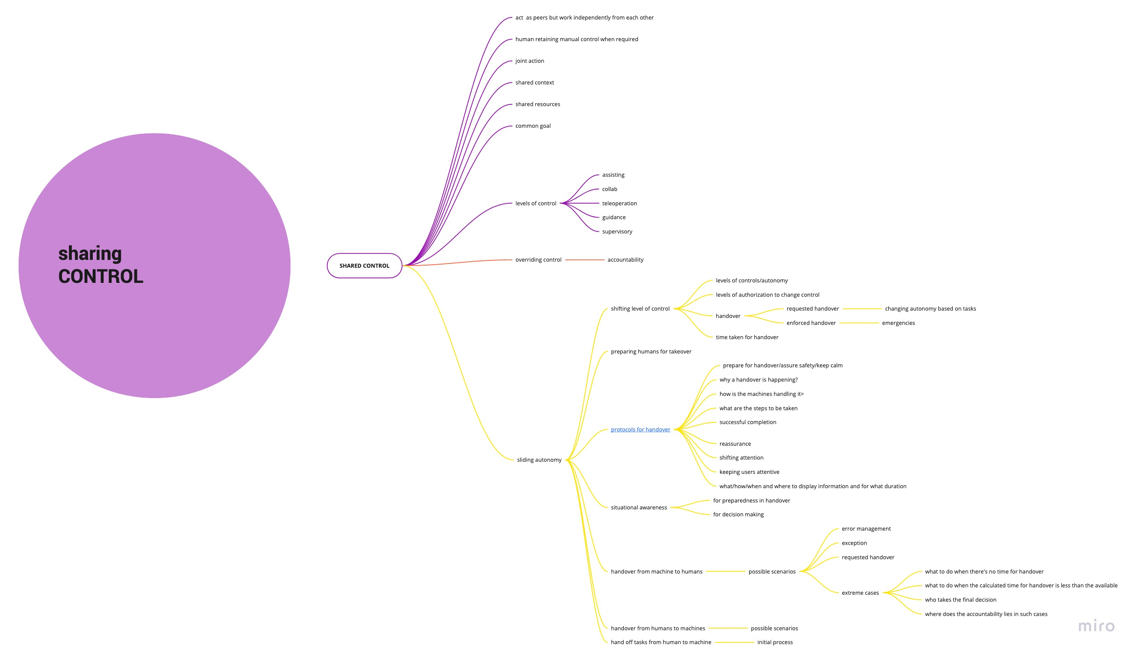
6.3.8 Pillars of the Framework ~ Sharing Control
How will they collaborate with AS?
How to approach the framework what qualities of humans and AS are strong which can be combined as a successful concotion of a successful collaboration
Media equation
Based on Siemens business, a framework is proposed to humanize collaboration with Autonomous Systems.
The framework focuses on Dyadic collaboration i.e. between 2 parties.
Different ways to approach/design fro these factors will result in different collaboration styles in different situations.
Different situations will demand different ways to approach these factors for efficient results

Slide 47
6. Focus Areas~ Research

Slide 48
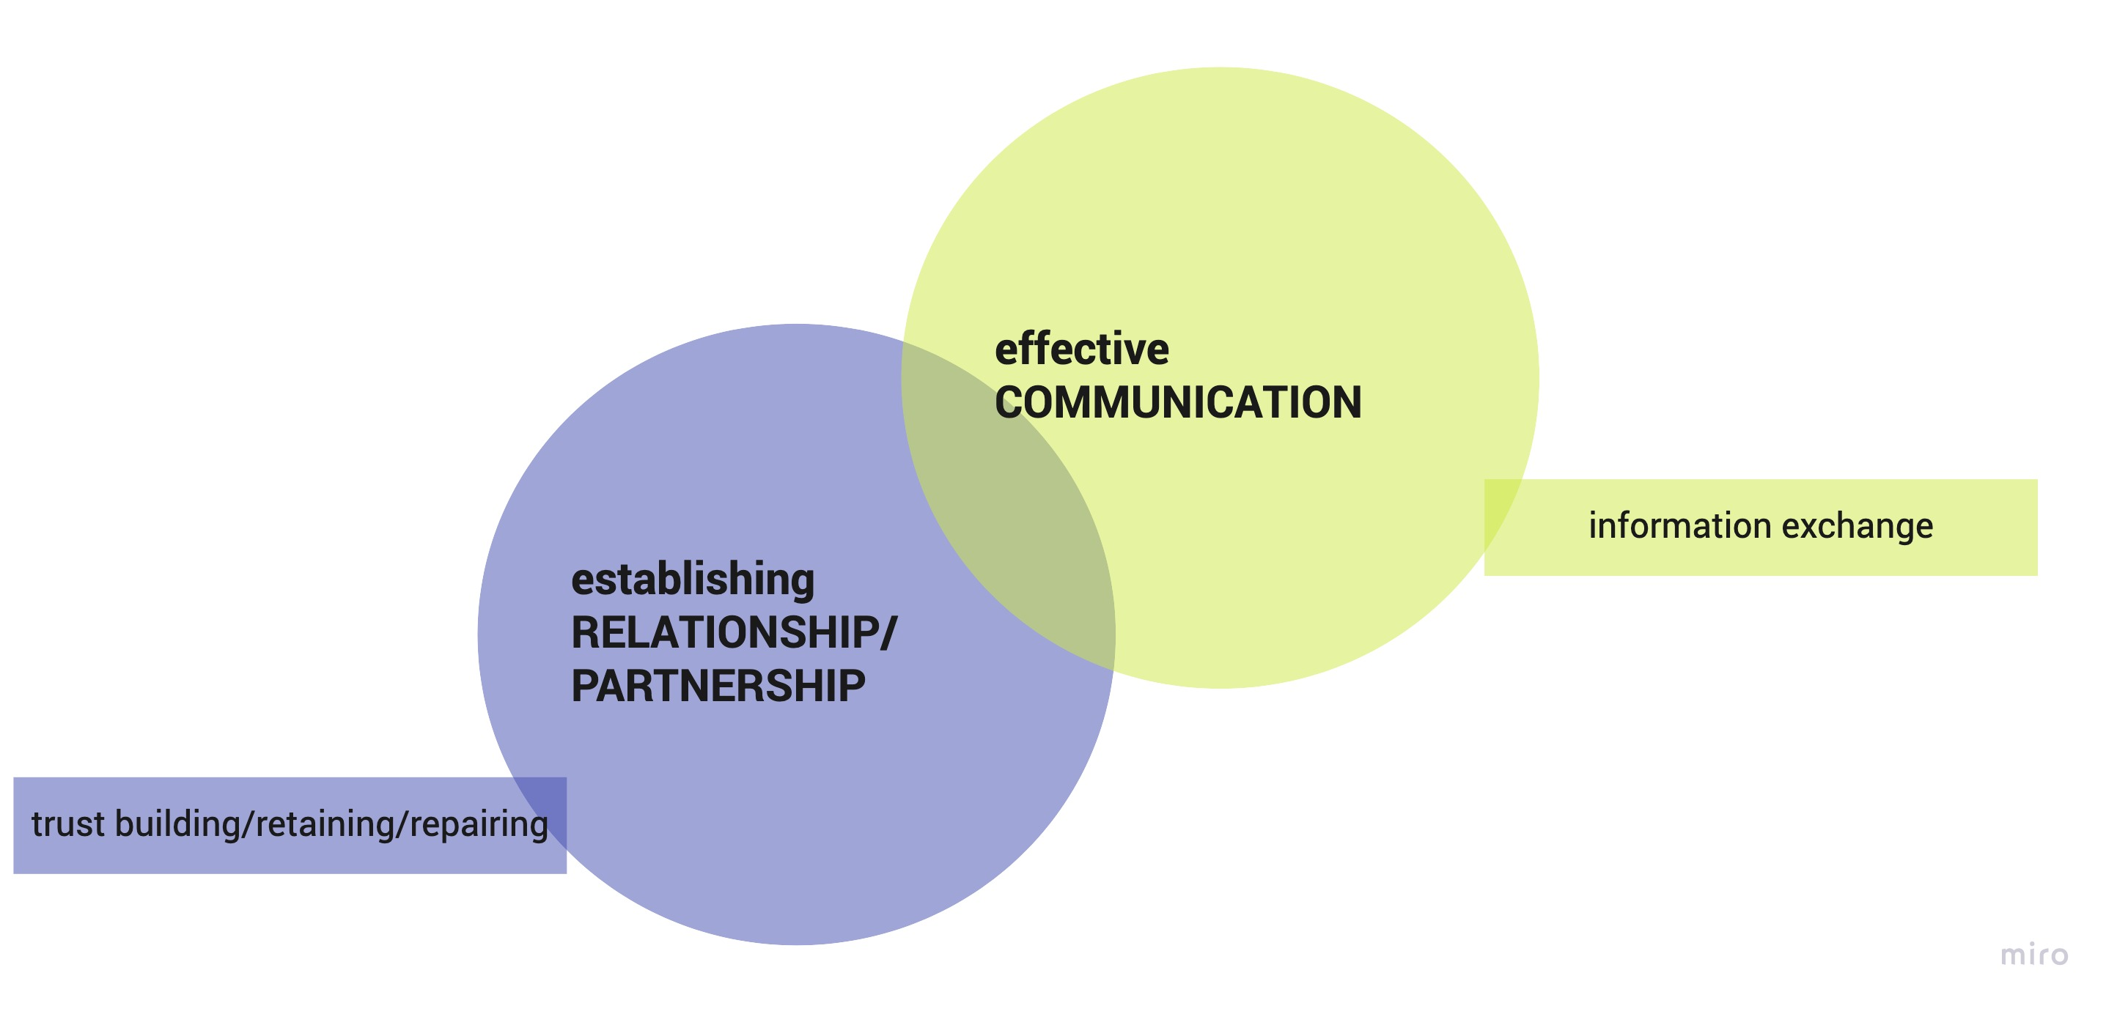
6.4 Narrowing the scope ~ Defining the areas of focus
Domain of focus
2 Pillars of Framework
The domain of Autonomous car was selected for narrowed scope, because of its popularity as a use case and it’s alignment with Siemens’ Mobility Domain.
Establishing relationships by building trust & Facilitating communication by information exchange were choses to be the area of focus as these 2 domains were understood to have the most impact which familiarizing with new technology. Trust and communication are the 2 key pillars of human-human collaboration and therefore were considered as focus areas for further research.

Slide 49
6.4 Narrowing the scope ~ Understanding the domain
Autonomous Cars
Autonomous cars are slowly becoming popular in mobility domain. With more popular use cases like car rental being rapidly tested and infrastructure being developed for them, different level of self driving cars are coming on road for different target users.
Figure 1. SAE ~ Levels of driving automation
As defined by Society of Automotive Engineers(SAE) To understand this domain better, a secondary study was conducted. The aim was to understand various aspect of self driving cars. Different levels of driving automation in cars define the passenger interaction with the car, the level of control with the driver vs cars, and the nature of handover of control from car to driver & vice versa.
To understand the levels of driving automation, in car interactions and communication interface, a secondary study was conducted for the below mentioned models -
TESLA MODE S - AUTOPILOT LEVEL 2 (driving assistance, not hands free)
WAYMO ONE Level 4 self driving car

Slide 50
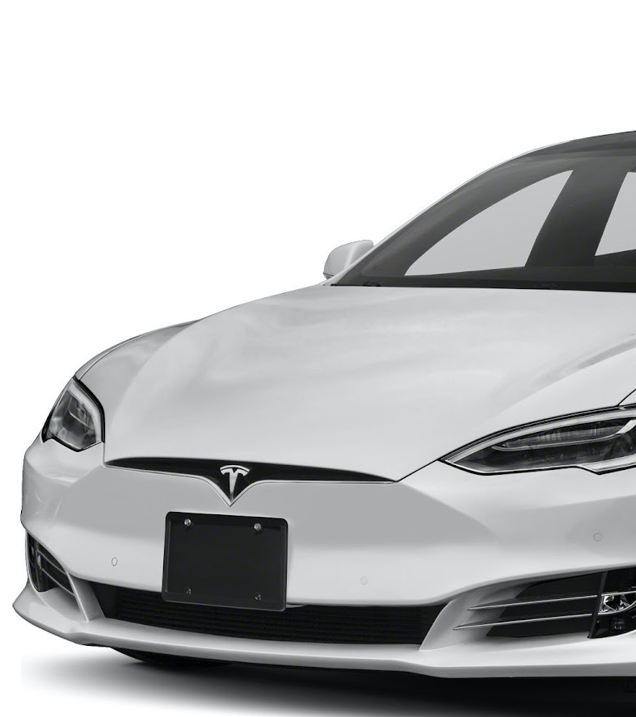
2.1 Autonomous Cars
Tesla Model S(LEVEL 2)
Must keep hands on wheel all time
Sound indication of car taking over Indication on dashboard of automatic mode aren’t clear, a blue wheel icon appear which rotates with the wheel; a message saying, ‘please keep your hands on the wheel appears’ and ‘autosteer speed restricted to X kmph’.
Change lane require hands on wheel(pressure points on wheel to detect that)
Grey steering icon when car can be set on autopilot
Manual mode-lane change without indication gives warning to ‘take control immediately’ and make sound
The person is not able to look away from the windshield or road
Sound when person takes over the steering suddenly; blue icon blinks twice and disappear-override
Doesn’t indicate the user before hand that the autopilot mode is going to be turned off and the driver has to predict and take control
Indicates the user when it is going to changes lanes but not when it pick a lane at the signal and might pick wrong one without giving the driver a chance to correct it
Reading lane arrows can confuse the car
Road infrastructure is very important for Tesla Level 2 autopilot mode as it relies heavily on lines and marking
Reads traffic information slower, like how far ahead cars are etc.
Figure 1. Tesla Model S

Slide 51
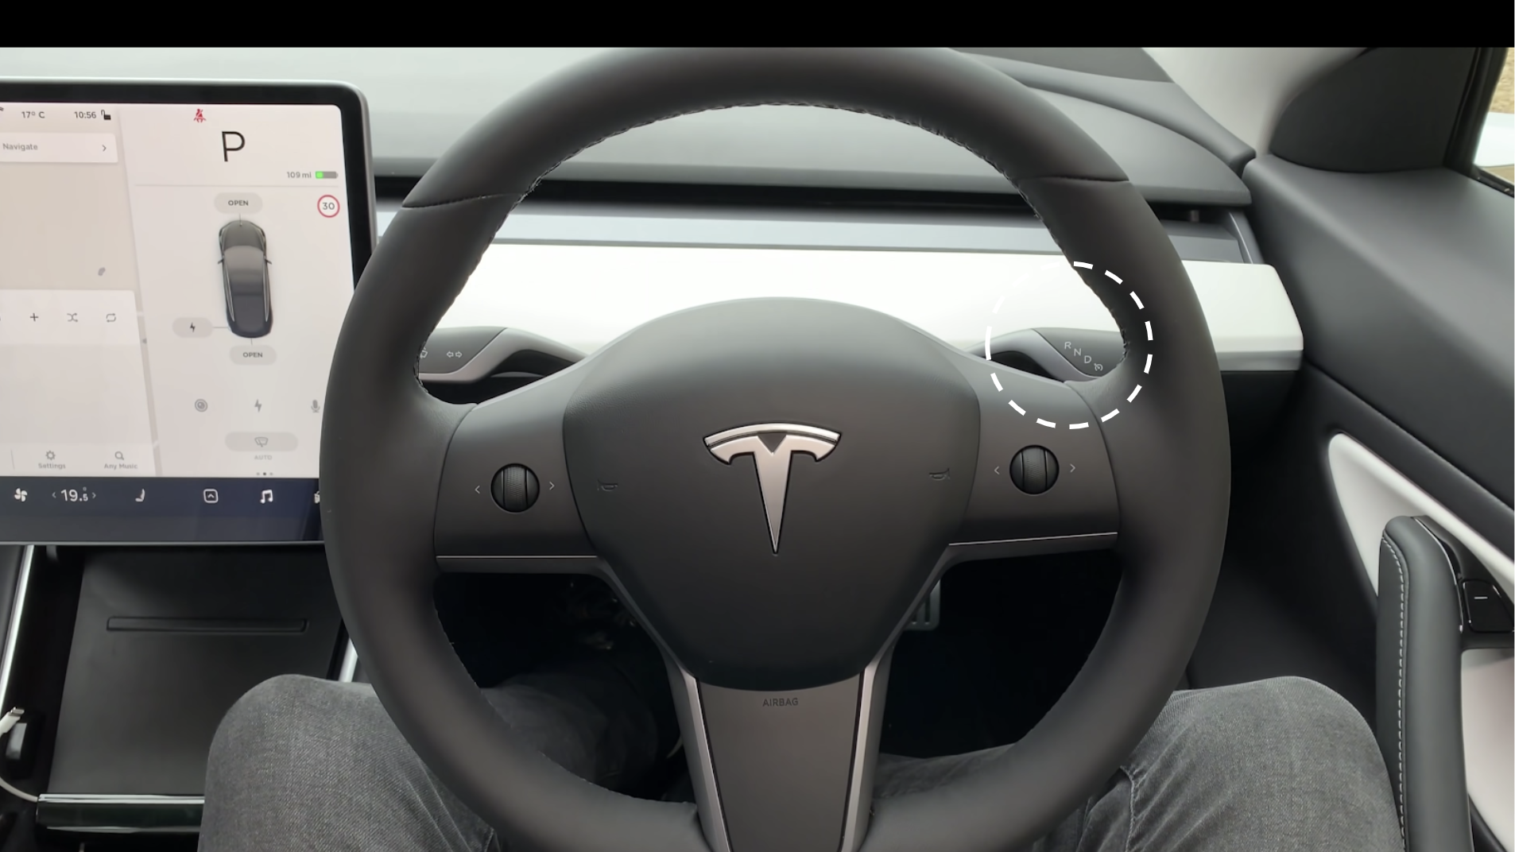

Slide 52
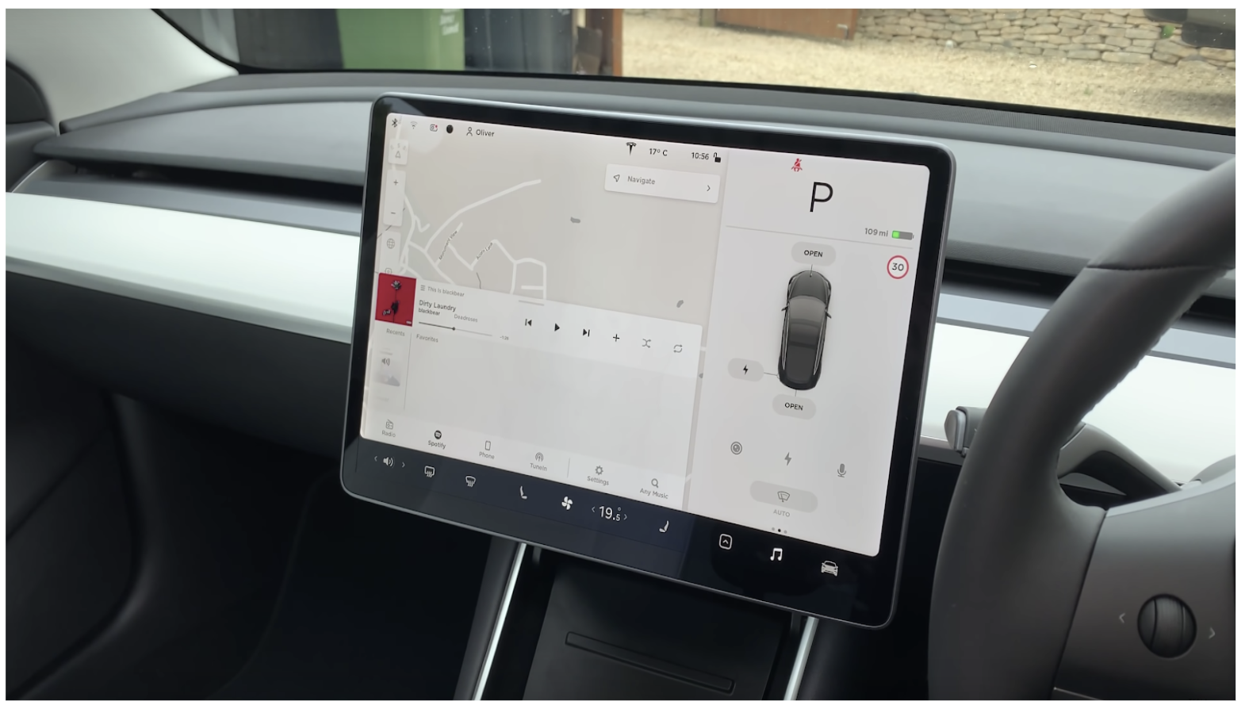

Slide 53
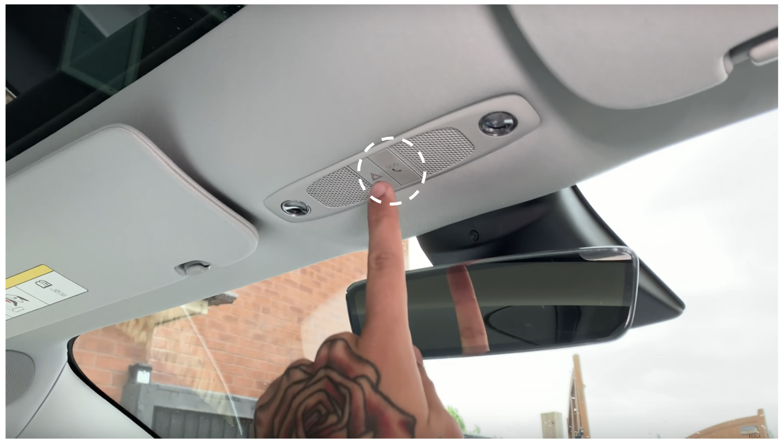

Slide 54
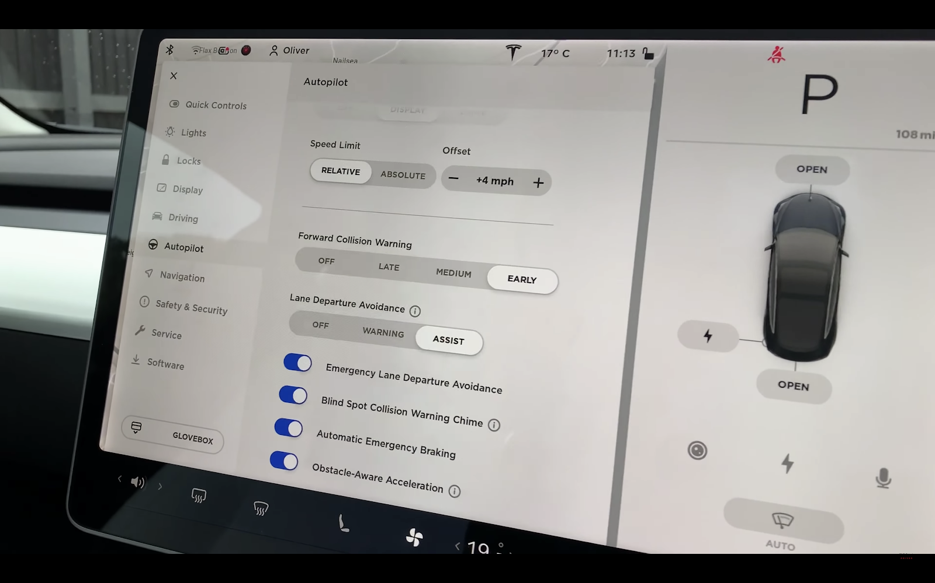
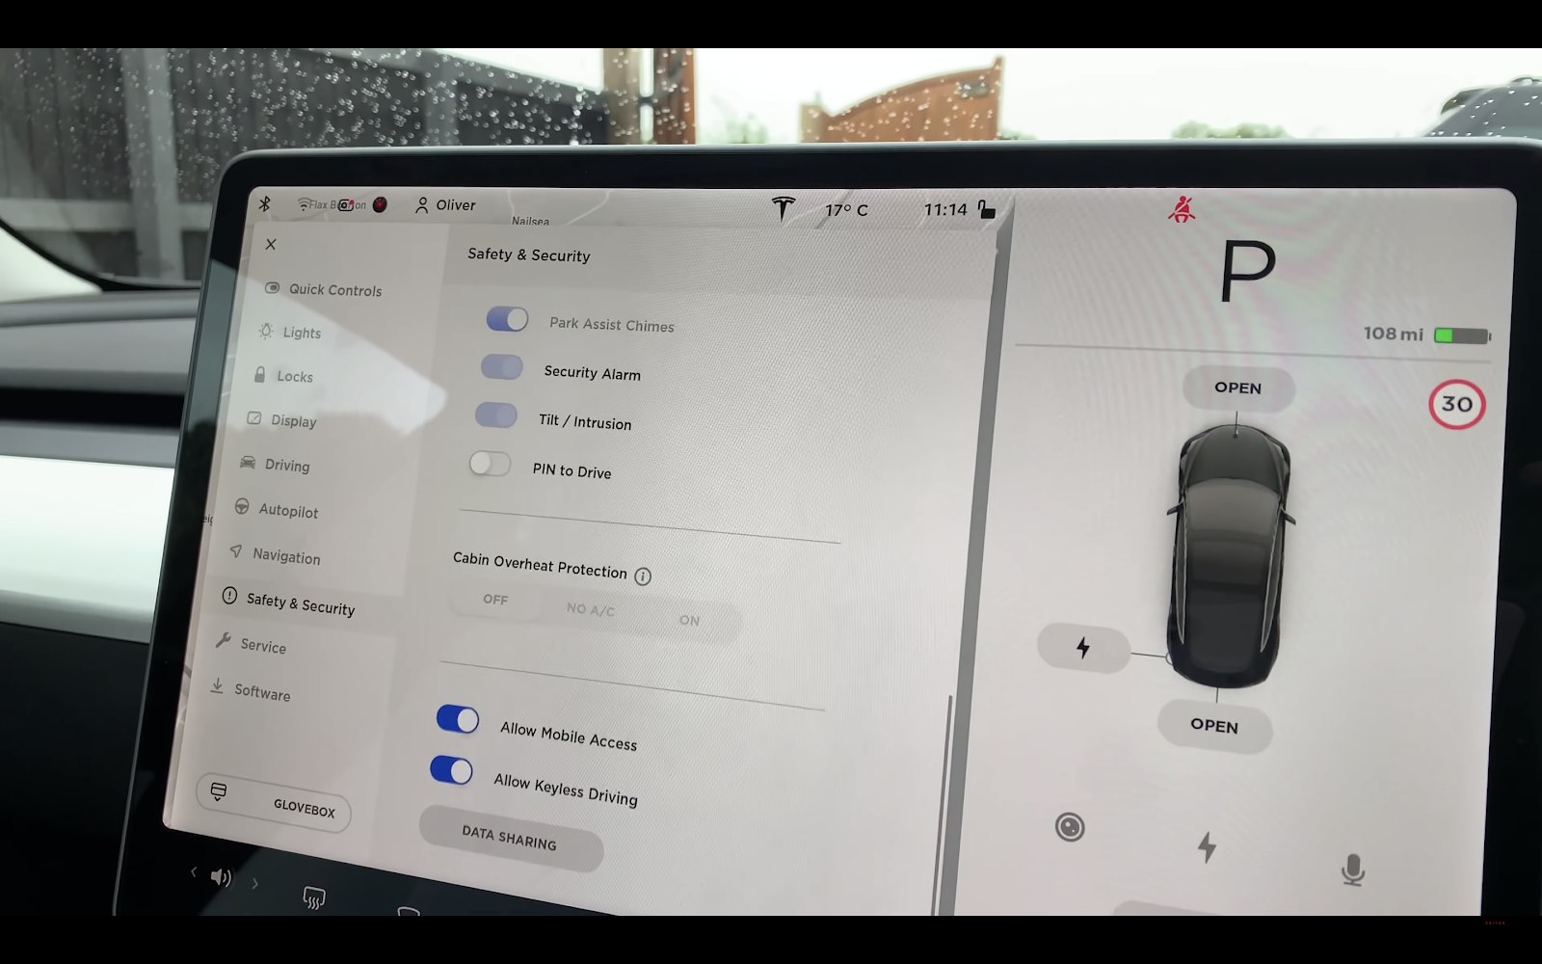
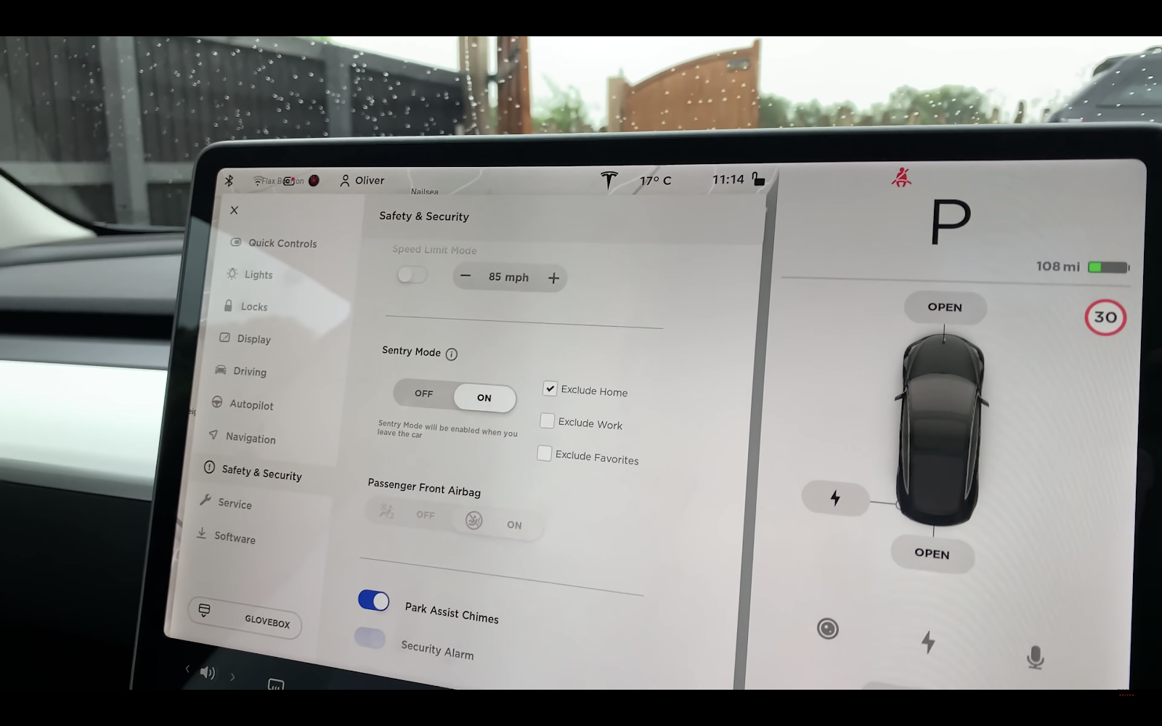
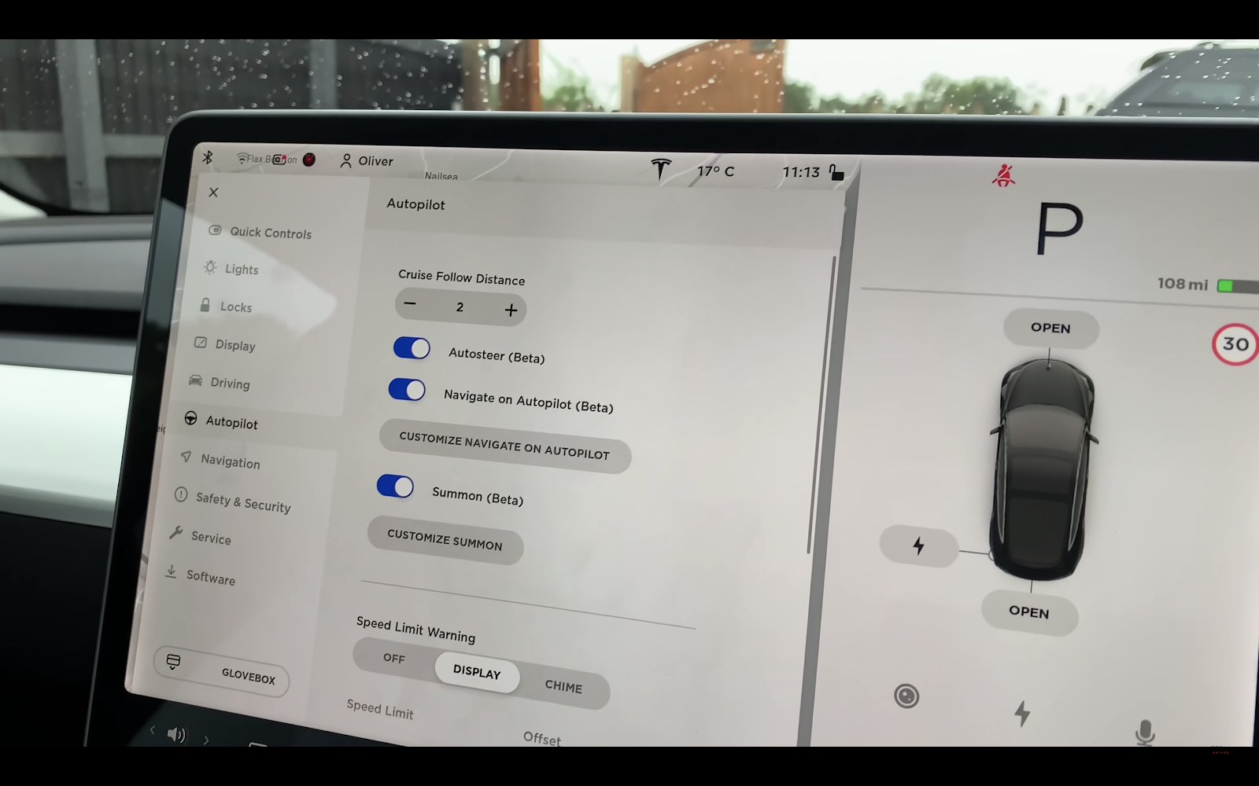

Slide 55
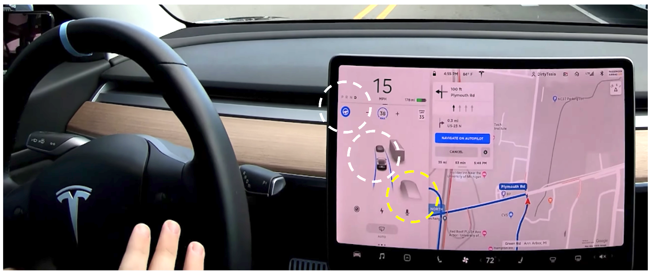
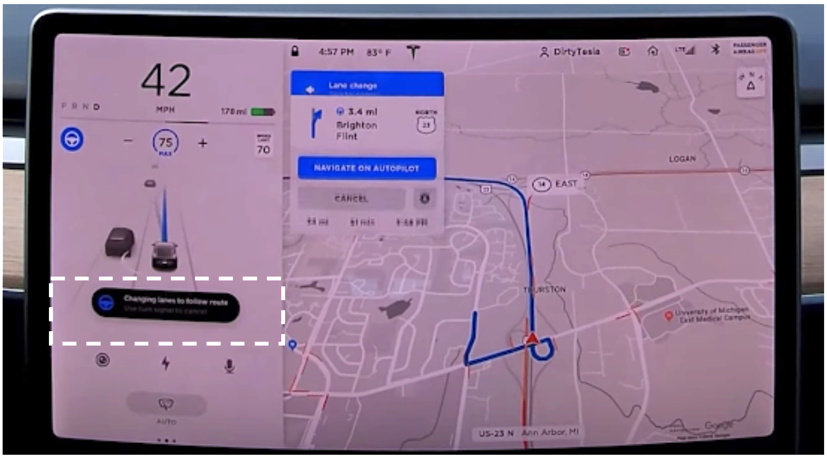
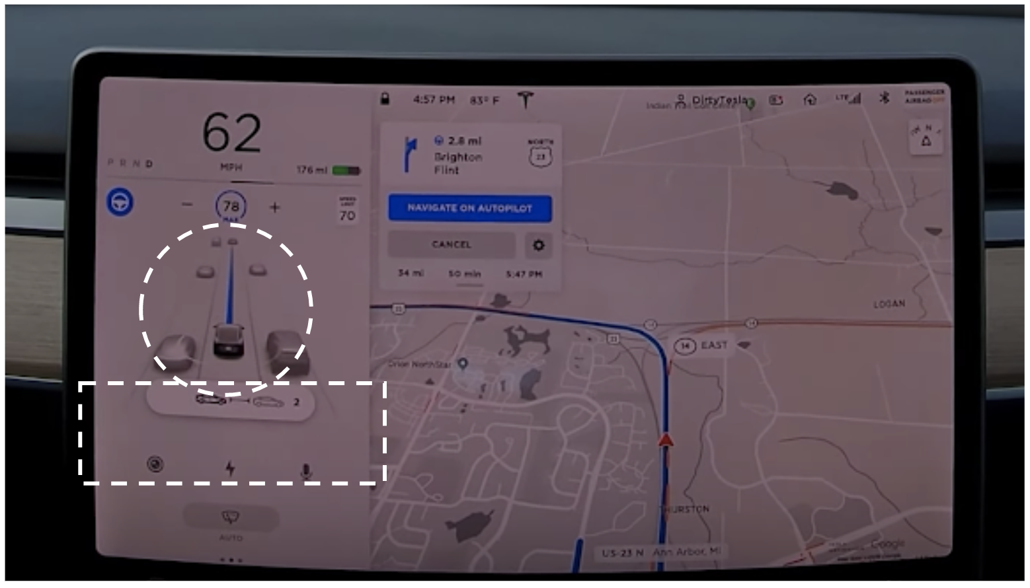

Slide 56
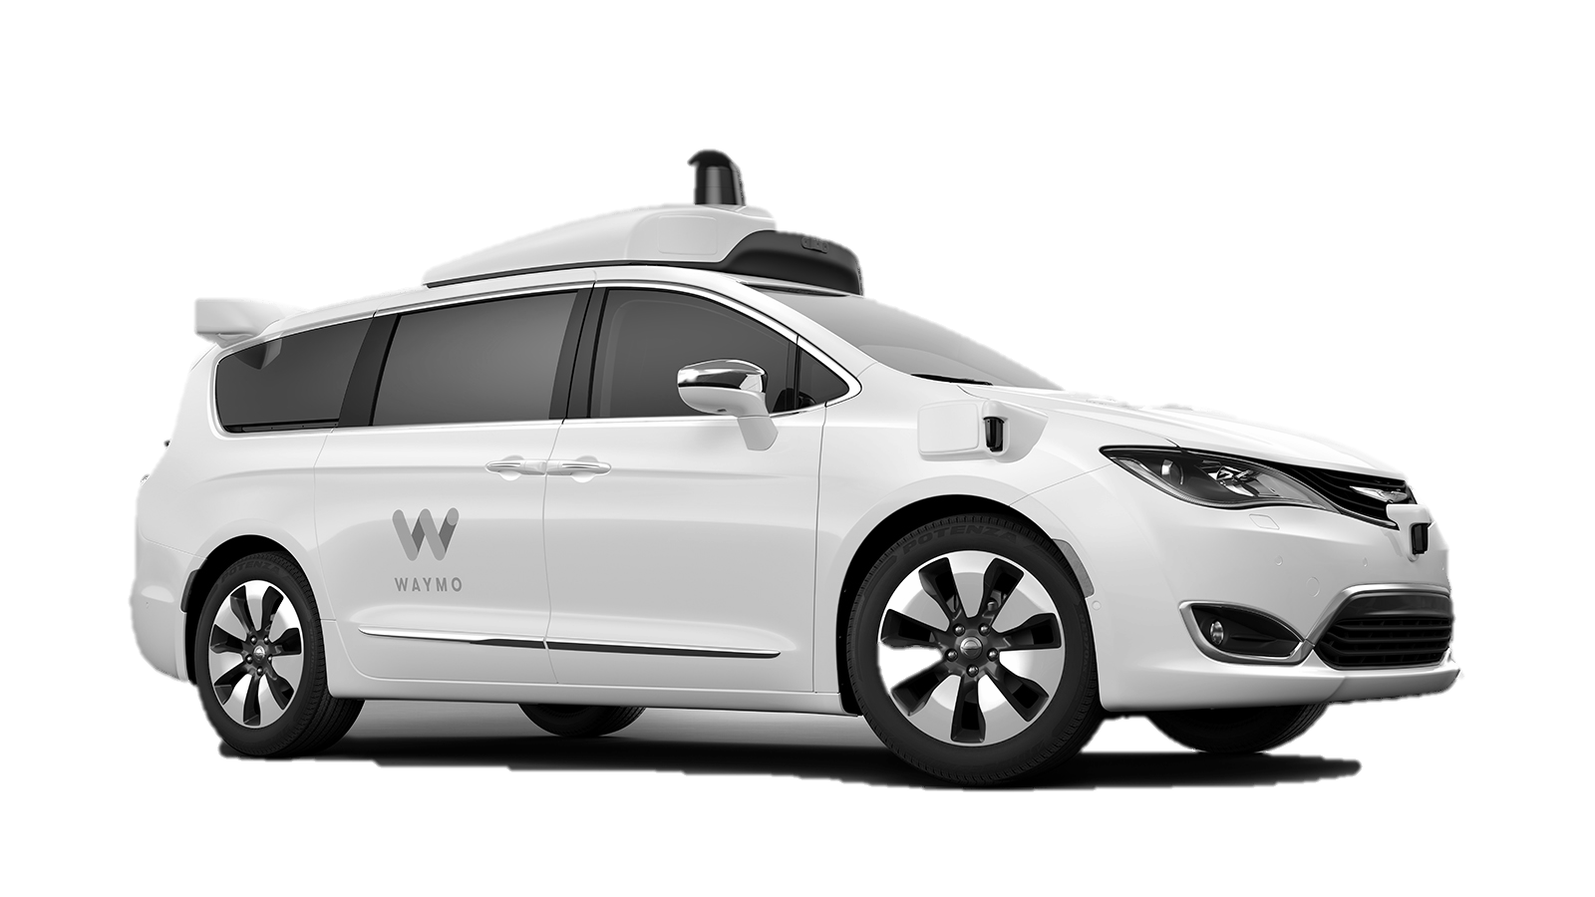
2.1 Autonomous Cars
WAYMO ONE(LEVEL 4)
Lowest rate of disengagements-where humans have to take control
Has problems, takes lot of time switching lanes and taking turn and confuse/annoys other driver with its erratic/sudden decision changes and cannot communicate its decisions properly with the other drivers
Mini dash at the top for back seat passenger– (start ride(blue color), pull over,lock/unlock,help )
Screen on the back(head rest ) of front seats to show the passengers live view what the car is doing, where it is going etc(transparency for the passenger)
Cars are programmed to be extra cautious and conservative safe drivers
The chauffeur(safety drivers as they call) is always looking at the road being cautious despite not driving the car(like neither is he a proper driver not a passenger – a very uncomfortable situation), but Waymo put the chauffeur in front seat in the first place because people were uncomfortable without a driver
Steering keeps rotating
People still keep looking through the front windshield on the road
Drop off points can be specified in apps
traffic information slower, like how far ahead cars are etc.
Figure 1. Waymo One

Slide 57
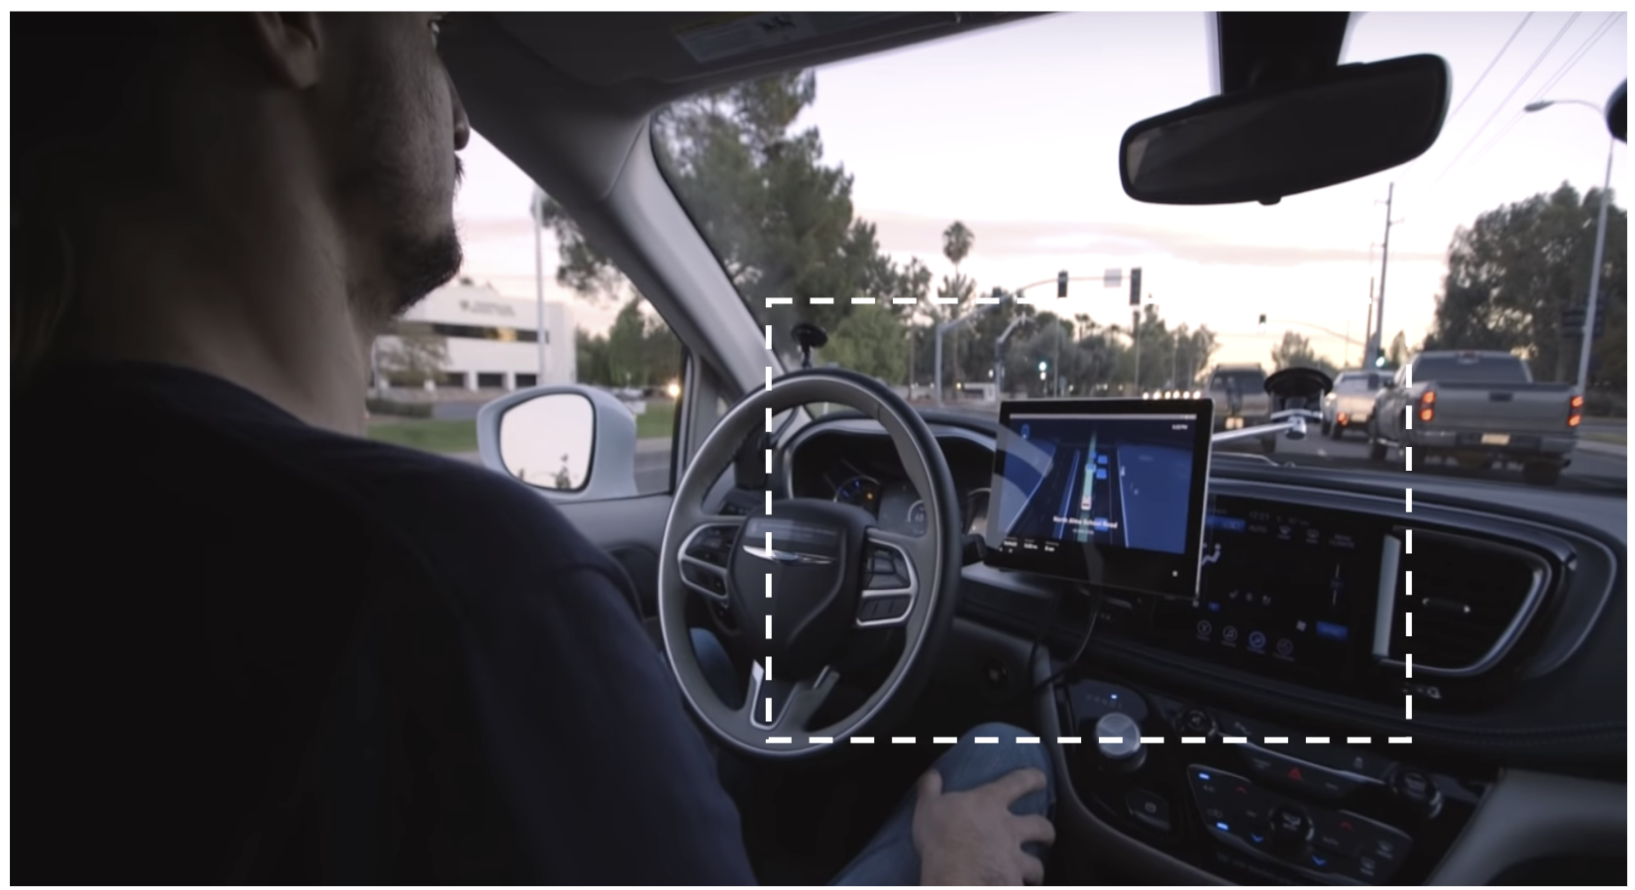

Slide 58
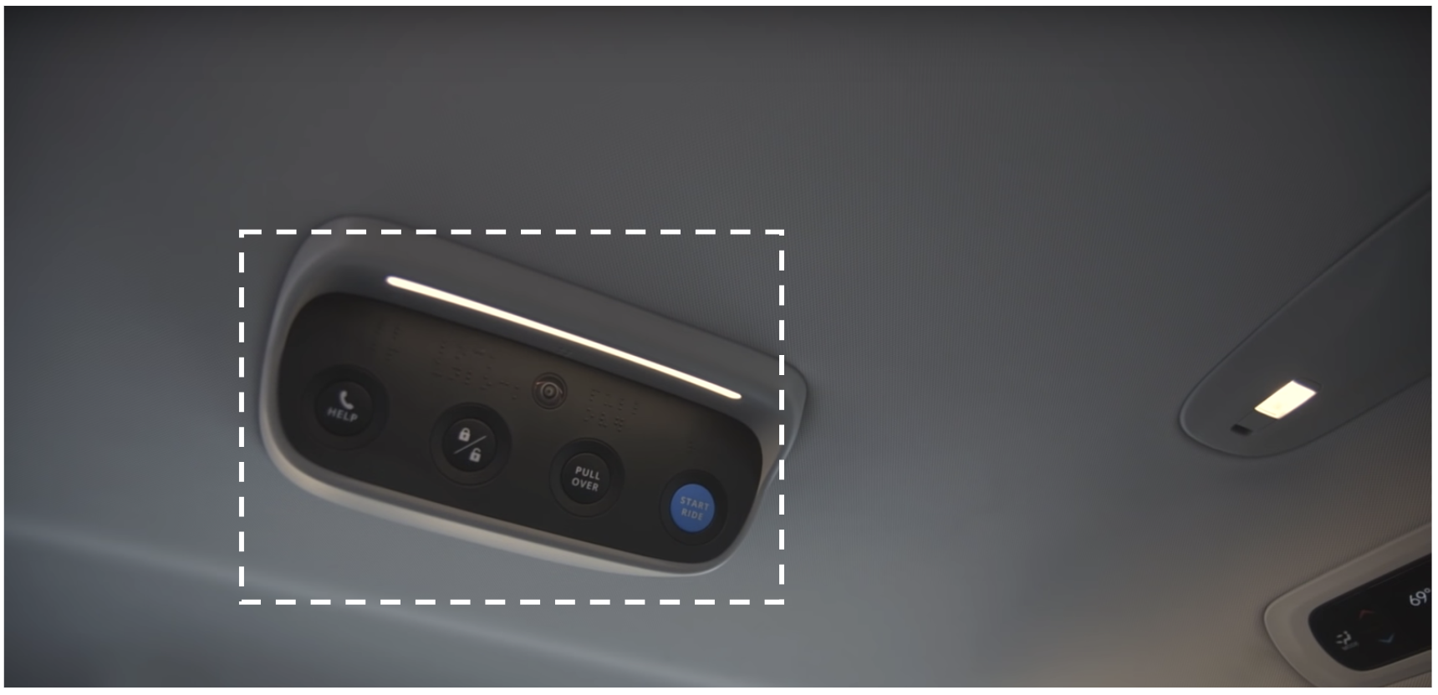

Slide 59
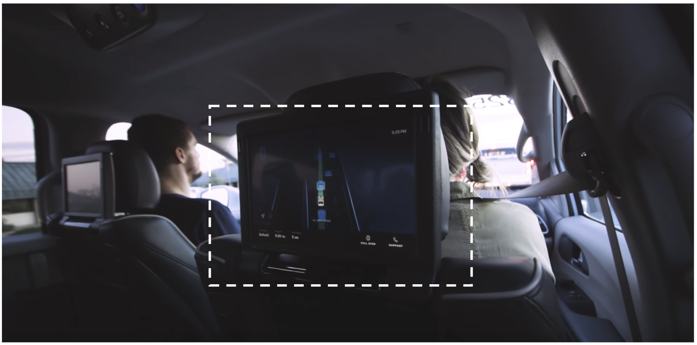

Slide 60
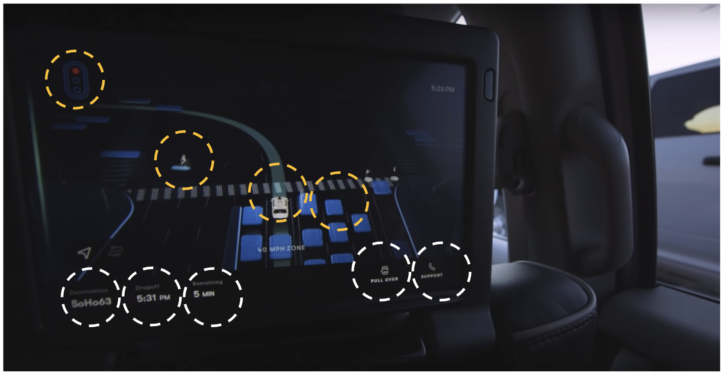

Slide 61
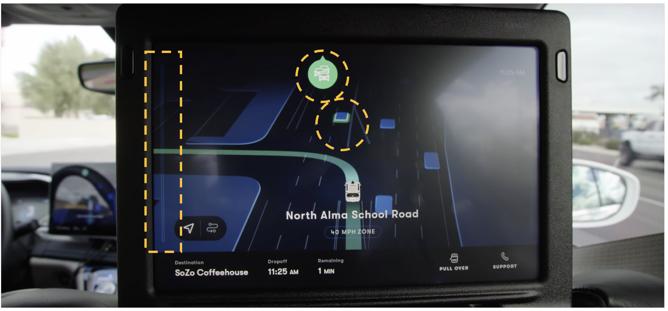
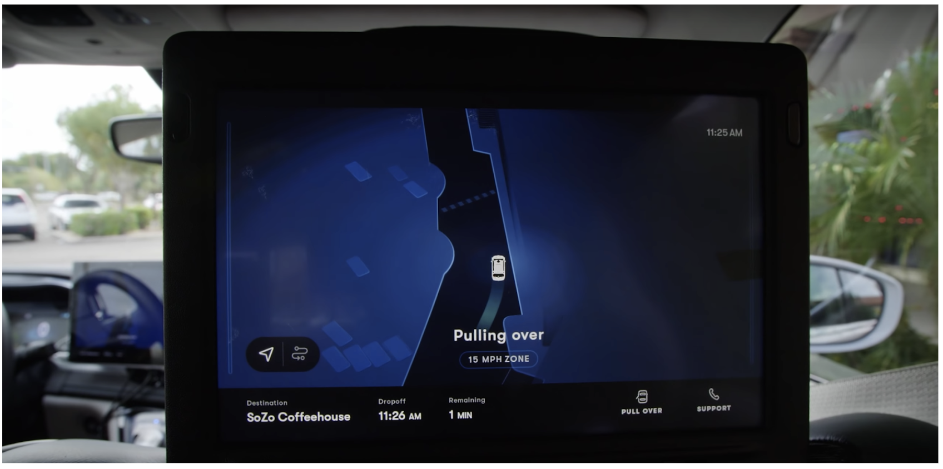

Slide 62
6.5 Understanding On Road Interactions
Public space
Your Autonomous Car
Other Autonomous Vehicles
Pedestrians
External communication
Manual Vehicles with driver & passengers
Personal space
Internal communication
Car’s communication Interface
Figure 1. Autonomous Car’s on-road Interactions

Slide 63
6.4 Narrowing the scope ~ Defining the areas of focus
How does collaboration look here when we focus on these 2 factors?. How can we make collaboration more effective by focusing on these 2 factors? How do these 2 factors make collaboration for effective?

Slide 64
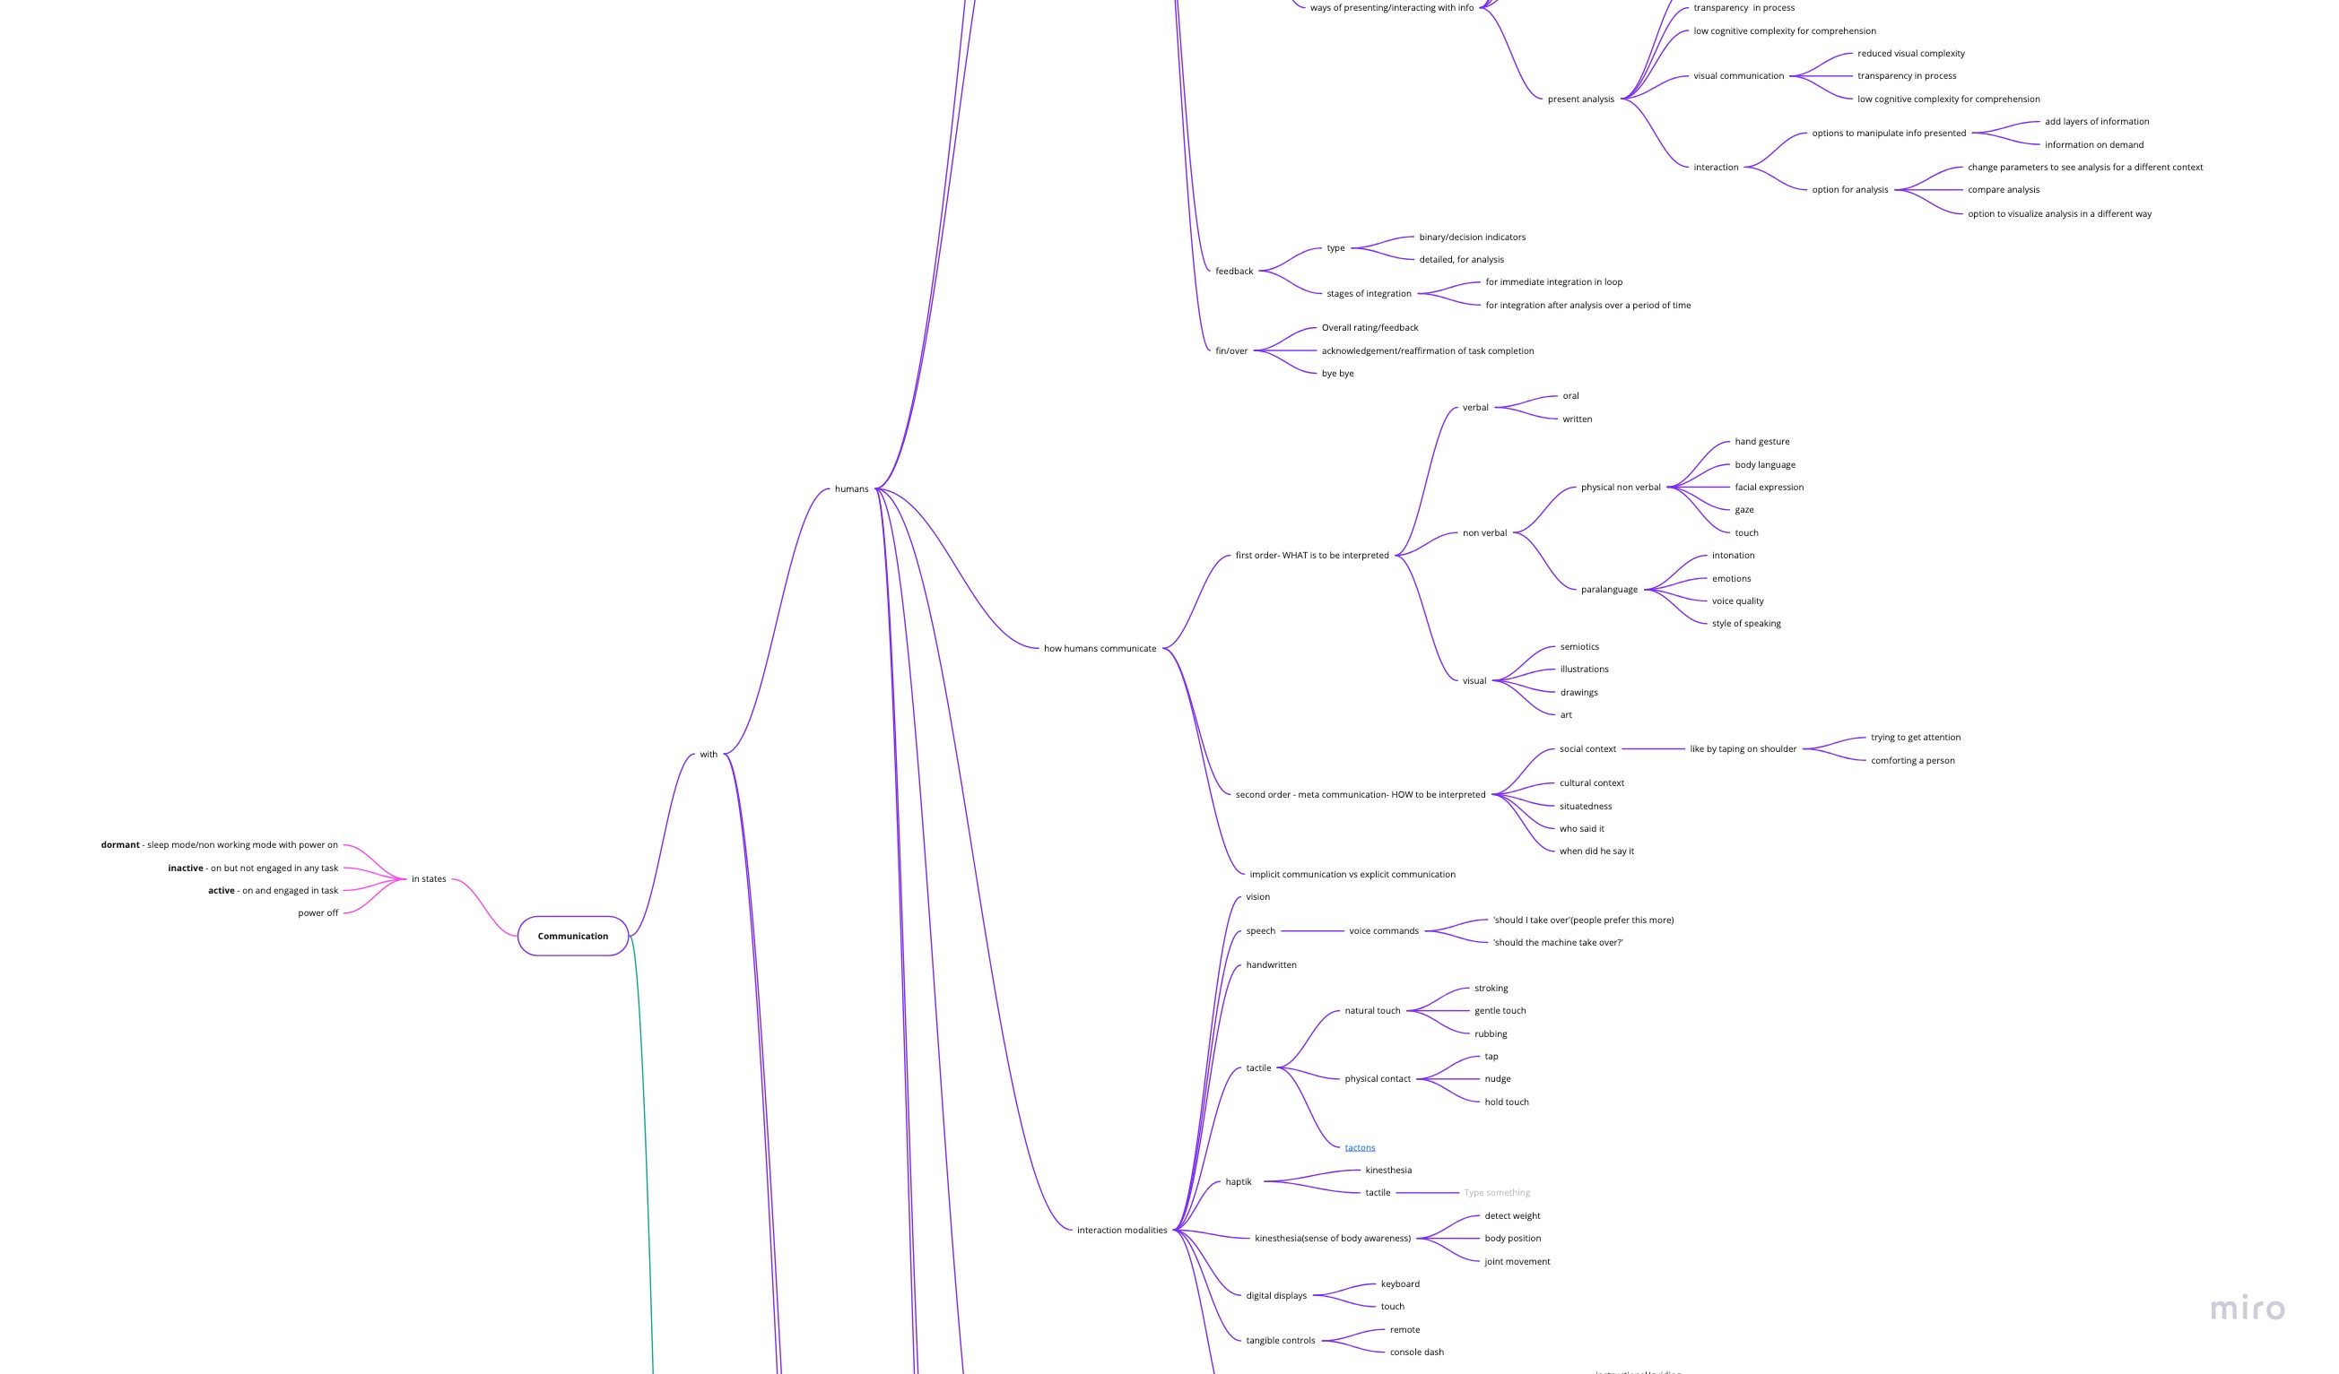
6.5 Effective Communication ~ Information Exchange framework
Full framework Link : https://miro.com/app/board/o9J_kwrwnSg=/

Slide 65
6.5 Establishing Relationships ~ Building Trust
Important building blocks driving trust on automation
Expectancy of a promise being fulfilled by other individual
Expectancy of success in terms of some future event
Expectancy of technically competent performance
Expectation of compliance and fulfilling obligation when needed
Expectation of moral obligation in social relationships
Willingness to place oneself in a relationship that establishes or increases vulnerability
Reliance on someone to perform as expected
Willingness to rely on someone and show confidence in them
Willingness to be vulnerable to the action of others based on expectation that the other will perform an action important to the trustor
Willingness to put themselves at risk by delegating responsibilities for action to another party
Willing to believe in intentions of others to perform a task as expected by you
Ability of a trustee to perform as expected by trustor
Performance of an agent who furthers the trustors' goal
Goal oriented/Team Player nature of fulfilling a shared goal
Intention to compete a goal shared or ascribed
Transparent exchange of information
Ability
Desire
Intention
Touchpoints where trust building can have a significant impact
Guides decision when complexity and unanticipated situations make the complete understanding of automation difficult
Mediating how people rely on each other and
Important for reliance on machine as human perceive technology through a social lens[media equation]
People rly on automation they trust and reject automation they don’t trust
Trust helps ibn overcoming cognitive complexities which people face in managing increasingly sophisticated automation
Trust is impertinent in cross disciplinary and cross collaboration
Trust helps collaboration in work place according to organizational theory
Trust is important in promoting efficient transactions & cooperation
Trust helps in situation of rapid adaption to change and to accommodate unanticipated variability
Trust plays a critical role in people’s ability to accommodate the cognitive complexity & uncertainty
Trust guides decisions when situation demands adaptive behavior that procedure cannot guide
Trust supplants supervision when direct observation become impractical

Slide 66
6.5 Establishing Relationships ~ Building Trust
Primary research
As a part of the project, primary research has been conducted at various steps as and when required, to understand the various stakeholders, their thoughts/opinions/views, their roles , their behaviors , journeys , needs, comforts and discomforts in the context of this project
1
2
3
Hypothesis Testing
Individual Interviews
Walk me through your process
A quantitative + qualitative study to test hypothesis statements formed from literature review and my understanding of users.
A qualitative study to understand humans in the context of autonomous cars and cobots.
A qualitative study that asked people to imagine and walk us through a given imaginative scenario by thinking out loud.

Slide 67
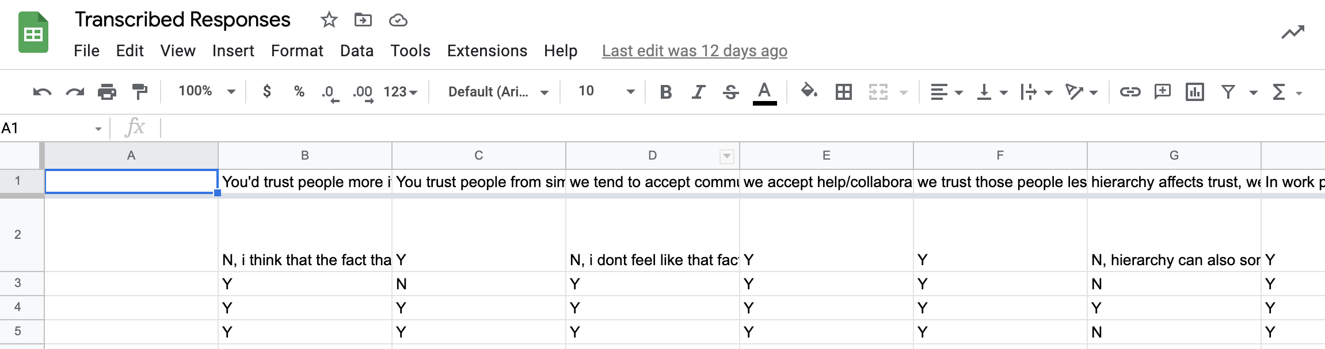
6.5 Establishing Relationships ~ Building Trust
1
Hypothesis Testing
The study is a qualitative + quantitative study to understand in depth about the reasons/rationale behind people's way of building trust in different situations. A stratified sampling method was used to accommodate different working styles to get a broader perspective on collaboration. After completion of the study, based on the true/false(along with reasons and rationale), insights were formed that would be helpful in designing a concept for effective collaboration with future co workers(autonomous systems).
Users The study was done with 22 users and a stratified sampling method was used to have a diverse representation.
Environment/Setting People were asked to engage in this activity, when they came back from their offices, at the comfort of their homes where they could think/express more freely and reflect on the day's work. They were given a context of workspace to base their answers on.
Data Collection & Analysis After individual interviews, the data was transcribed into an excel sheet for analysis. Step 1 - All the statements which
received more than 50% positive response were considered as useful insights. Step 2 - For the statements that turned out false, user’s reasons were analysed for possible insights. Based on the previous steps, final insights were formed.
Figure 1. Transcribed Responses

Slide 68
4.1 Identifying opportunity ~ Key observations till now
Hypothesis Statements

Slide 69
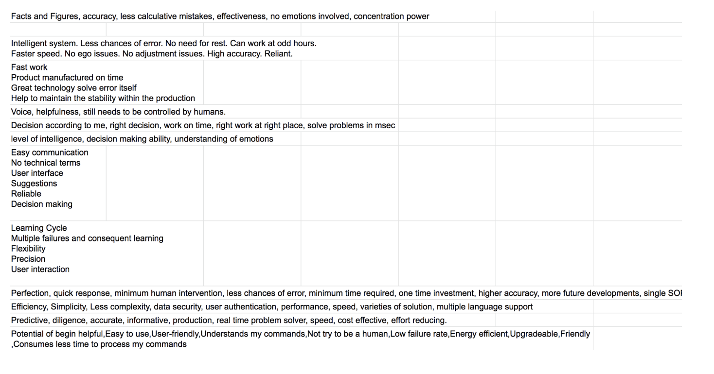
6.5 Establishing Relationships ~ Building Trust
2
Individual Interview
After the hypothesis testing, a list of questions were asked to people to get answers to question for which hypothesis couldn’t be formed due to lack of information.
Users The study was done with the same user who participated in hypothesis testing. Out of 22, 20 users agreed to go ahead with the study.
Environment/Setting People were asked to engage in this activity, when they came back from their offices, at the comfort of their homes where they could think/express more freely and reflect on the day's work. They were given a context of workspace to base their answers on.
Data Collection & Analysis After individual interviews, the data was transcribed into an excel sheet for analysis and used to form useful insights.
Figure 1. Transcribed Responses

Slide 70
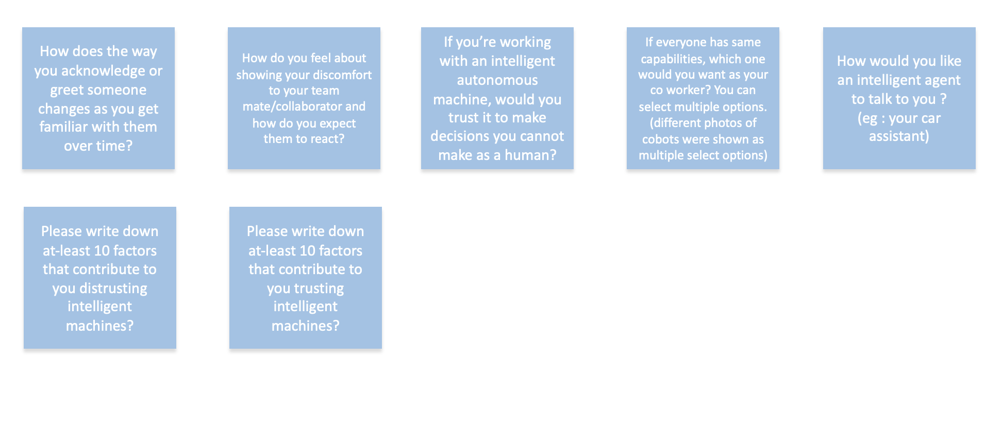
4.1 Identifying opportunity ~ Key observations till now
Interview Questions

Slide 71
6.5 Establishing Relationships ~ Building Trust
3
Walk me through your process
The study was an activity to understand how users approach and get interested in a new and unfamiliar technology and their process in getting acquainted/interested in the technology.
Users 5 users were asked to imagine a scenario and think out loud the steps involved in the entire scenario.
Scanarios Imagine you are in an AutoEXPO and you come across a car displayed as an autonomous car. What would be your process of getting interested in the car, checking it out and getting interested buying the car?
Data Collection & Analysis After individual interviews, the data was transcribed into an excel sheet for analysis and used to form useful insights.

Slide 72



4.1 Identifying opportunity ~ Key observations till now
Discovery Phase
Introduction Phase
Familiarity Phase

Slide 73


4.1 Identifying opportunity ~ Key observations till now
Interaction Phase
Decision Phase

Slide 74
6. Humans in the Loop

Slide 75
6.6 Target Personas – Humans in the Loop(HITL)
Mrs. Maria Joseph
Mr. Amari Obama
Mr. Robert Hansen
The pedestrian
Rental car passenger
Self driving car owner
Often ignored in designing autonomous mobility solution due to not being a direct interactor, however a key player in on-road interaction which is the ecosystem of autonomous cars.
Due to the unpredictable nature of human being and they view technology from a social lens [10], this persona on road leaves a large scope for integration in existing ecosystem.
Autonomous cars have a very popular use case as rental cars and are already being used as rental in their current stage of autonomy. Even though rental cars right now have designatory drivers, they are for meant to ease the passenger, engage them, give a sense of safety & not make the experience alien for them. But as cars move to higher autonomy, passengers using rental car for short/long duration have high interaction with the car within the car space as the in-car communication replaces the drivers and his role.
People are also actively adopting self driving tech at different levels of autonomy in their daily lives. Families in countries that support autonomous vehicles with infrastructure have seen a growth in purchase of such vehicles. The owners are early tech adopters. They have a certain level of trust in these tech due to high adoption around them and supporting infrastructure and rules in place. Kids of such family are growing up with sophisticated tech and do not feel alienated by it.

Slide 76
6.6 Persona 1
Mrs. Maria Joseph
Age : 68 years old
Profession : Retired school teacher
Family : Lives with her son’s family
Hobbies : Going for walks, baking, reading, game session with friends, movies with kids
Maria is an elderly lady and a retired school teacher who lives with her family. Her family includes her son, daughter in law and 2 grandkids. She has a very active social circle and is very outgoing for daily fun activities. She likes walking to different places nearby instead of taking a car. Her son is an early tech adopter and own an autonomous car which she never uses except on family trips. She is very aware of the rapid pace at which technology is transforming around her, and in this period of transition, she’s trying her best to get comfortable with the changes as much as possible. However, the complexity and sophistication of the technology in such close vicinity to her, still makes her feel alienated.
Devices
iPhone, Kindle Reader, iPad, smart speaker/assistance, smartwatch, wireless charger
Frustration
Even though she accepts technology due to her family actively adopting it, she’s skeptical and feels alienated around highly sophisticated technology that is replacing human interactions in daily activities.
Goal
Do her daily day today chores without getting uncomfortable and inconvenienced by technology that feels intrusive in her life. Get more familiar & build trust for technology that people around her use in their day today life
Introvert
Extrovert
Control
Let Go
Risk Averse
Early Adopter
The Pedestrian
Thinking
Feeling

Slide 77
User Journey on road
Maria goes for a walks to the park to meet her friends. Even thought the park is a little far, she doesn’t want to go via the autonomous car his son has as she is new to this complex technology and feels alien around it. However, she’s trying her best to get comfortable around the tech.
While crossing the road Maria when the signal turns red, the signal goes green in the midst. She looks towards a car, and she can see no human/driver and only reflective glasses. Assuming the car to be autonomous, she is in a state of confusion as to whether the car will move or should she continue crossing the road. Being used to meta communication with drivers while on road, she is scared for her safety.
While chatting with her friends in the park, they see a lot of autonomous cars go by with passenger. Seeing little kids in these cars, they feel skeptical about the sophisticate technology that lacks familiarity and can’t emote to connect with the social world. They wonder how people are comfortable with trusting them with their lives. They discuss how they’ll never allow their grandchildren to travel alone in these cars.
Touch points for trust

Slide 78
6.6 Persona 2
Mr. Amari Obama
Age : 33 years old
Profession : Business owner, Tech industry
Family : Lives with his family
Hobbies : Buying new gadgets, golf, VR gaming, trying new cuisines, weekend parties
Amari is a businessman from South Africa with his business clientele based majorly in Europe. He live in South Africa with his mother, father, brother and sister-in-law. His family owns 3 cars, none of which are self driving cars, due to the unavailability of supporting infrastructure for autonomous vehicles in South Africa. He frequently visits Europe for business trips and has been introduced to renting self driving cars. Being a tech enthusiast himself, he is curious and eager to try out new technologies and might buy one for himself if he likes the experience. He has sat in a self driving car before but usually with people he knows. On his next trip he is planning on renting a self driving car all for himself.
Devices
iPhone, Galaxy Fold, PS4, iPad, Garmin smartwatch, Macbook Pro, iMac, Smart home automation
Frustration
He is eager to buy an autonomous car for himself but due to lack of infrastructure and lack of experience with one, he can’t make an investment decision.
Goal
Wants to try and experience autonomous cars in their ecosystem ,get familiar with the technology so that he can buy it for his business trips where he prefers solitude while travelling.
Introvert
Extrovert
Control
Let Go
Risk Averse
Early Adopter
Rental car passenger
Thinking
Feeling

Slide 79
User Journey on road
Amari travels to Europe for his next business trip with a side agenda to try autonomous car rental and experience them in a supported ecosystem. He wants to understand the pain points and delights of the experience. He rents an SUV self driving car.
Next day the car arrives at his hotel parking from the nearest docking station. He gets ready, sits in his car and starts his ride. The first and foremost thing he feels is the lack of a driver, giving him a sense of losing control. It make him feel a little alienated. Even thought he is a persona comfortable with solitude, being all alone in the car gives him a sense of unfamiliarity & eeriness. There is an entertainment system inside which plays media; however, it is not enough to put him at ease.
While travelling, the car halts at various locations. One time the car halts for s slightly longer duration which makes him feel the need for a driver that will keep him update with the information and outside environment even when he is inside the car. Due to a sense of losing awareness, he feels uncomfortable as he is used to being extremely aware on road.
Touch points for trust

Slide 80
6.6 Persona 3
Mr. Robert Hansen
Age : 42 years old
Profession : Chief Software Designer
Family : Lives with his nuclear family
Hobbies : Yoga, golf, cross country rides, cooking, skiing, Friday night with friends
Robert works in service sector and is currently a Chief Software designer. He lives with his wife and 2 kids. His family is very comfortable around new technology and owns a self driving car for 4 years. He bought the car when it was launched as most of his colleagues praised the technology and he wanted to adopt to the new lifestyle. He doesn't feel alien around the tech anymore as he has been using it for a while. However, on road he still sense a discomfort from humans around. He wishes that his car adds a sense of joy and not a feeling of lack of safety on roach for other pedestrians. He wants people to adopt and trust the amazing technology as much as he does.
Devices
Galaxy Fold, HTC Vive, PS4, iPad, Smart home theatre, Macbook Pro, Gesture based home appliances
Frustration
He has been using his car for along time, however the car with its sophistical technology, still feels like a machine, lacks personalization and gives a sense of discomfort on road for pedestrians.
Goal
Personalization of car will help pedestrian be less skeptical with autonomous devices and create a sense of acceptable and trust around this technology. It will also allow him to express himself on road to pedestrians via the car and take away the discomfort.
Introvert
Extrovert
Control
Let Go
Risk Averse
Early Adopter
Self driving car owner
Thinking
Feeling

Slide 81
User Journey on road
Robert is planning to travel to his parent’s house for year end Christmas holidays. He is very excited for a road trip as he gets to spend quality time with his family and doesn’t even have to drive.
As they pack for their holidays, Robert’s kids remember the one time when they travelled via trail with their grand parents. The train was decorated with New Year décor, and they felt joyous and considered it the best train ride.
As the start their trip next day, there were busy road during festive season and people from all walks of life out on the street. With the traffic a bit unregulated, he saw many instances where people, especially young kids and elderly, were uncomfortable around the car after seeing no driving in the car. Even after owning the car for 4 years, the felt that he was out of place on the road and adding to the discomfort during a festive season.
Touch points for trust

Slide 82
6. The Concepts

Slide 83
6.6.1 Concepts
Humans in the loop
Personalized communication interface via Profiling Pedestrians
The Pedestrian
Car to Pedestrian interactions
Touch points for trust
Scared for safety, no human driver so uncertainty, no communication with driver, confusion on road
Information Exchange
The information exchange happens between the Autonomous System and Human beings i.e. Pedestrians.

Slide 84



Slide 85


Slide 86
6.6 Concepts
Humans in the loop
The Passenger
Select your Ride Buddy!
From Infotainment systems to Passenger Engagement Systems
The Ride Buddy acts as a communication interface with the car and is a co-rider, keeping the passenger engaged during the entire trip. It helps the passenger build trust with the car by feeling less lonely, and aids his sense of awareness and control by providing transparency in information as and when required.
Car to Passenger
Touch points for trust
Sense of losing control
Hindered awareness
Unfamiliarity and eeriness
Disconnected
Information Exchange
Information exchange happens inside car’s private space with the passenger

Slide 87


Customise your profile and experience a human touch
The users can sync their phone with the car info system and can keep themselves updated with their customised profile or their location and journey.
They can also use the feature to sync their experience and add a personal touch to their journeys.

Slide 88

Get answers for all your doubts and confusions
The smart system will help users to understand/identity and issues faced on the street which may include traffic, road block or damage on the road. This system helps users to stay informed on top of things and to be able to take decisions easily and safely.

Slide 89
6.6 Concepts
Humans in the loop
The Car owner
Personalize to express and add character
Technology that has a character invokes emotions and adds to trust as humans view technology from a social lens.
Touch points for trust
Sophisticated technology adds to discomfort around, complex systems are slow on adoption
Car to Environment
Information Exchange
Information exchange happens between the car and the pedestrian via personalization from the owner

Slide 90

Customise your car with your Personality
The smart system will help users to customise and showcase their individuality through the ability to add custom sticks and messages on the glass panels which acts as mirrors/ screen to portray one’s creativity/ individuality.

Slide 91

Themes and Categories for Fun-tainment
The smart system will help users to select from various themes such as Christmas, new years eve, summer, winter.. spring etc. They will have broader categories as weather, sports, nations etc.. which will help them customise the exterior of the car adding to their personality and freedom of expression.

Slide 92
References
Tool References
https://www.voxco.com/blog/exploratory-research/
https://courses.lumenlearning.com/suny-hccc-research-methods/chapter/chapter-12-interpretive-research/
Voros, J 2017, ‘Big History and anticipation: Using Big History as a framework for global foresight’, in R Poli (ed.) Handbook of anticipation: Theoretical and applied aspects of the use of future in decision making, Springer International
M. Luck, and M. d’Inverno, 1995, A formal framework for agency and atunomy
Motivation in psychology (Kunda 1990)
http://collaborative-intelligence.org/autonomy.html
Collaboration Framework – Miro https://miro.com/welcome/sr6RxjMPG91JU3Lvia83WAvTzXoNnteuKRRxeorqE2fmMID41WIODaIq2xmgbg5s

Slide 93
Thank you

